Slide 1
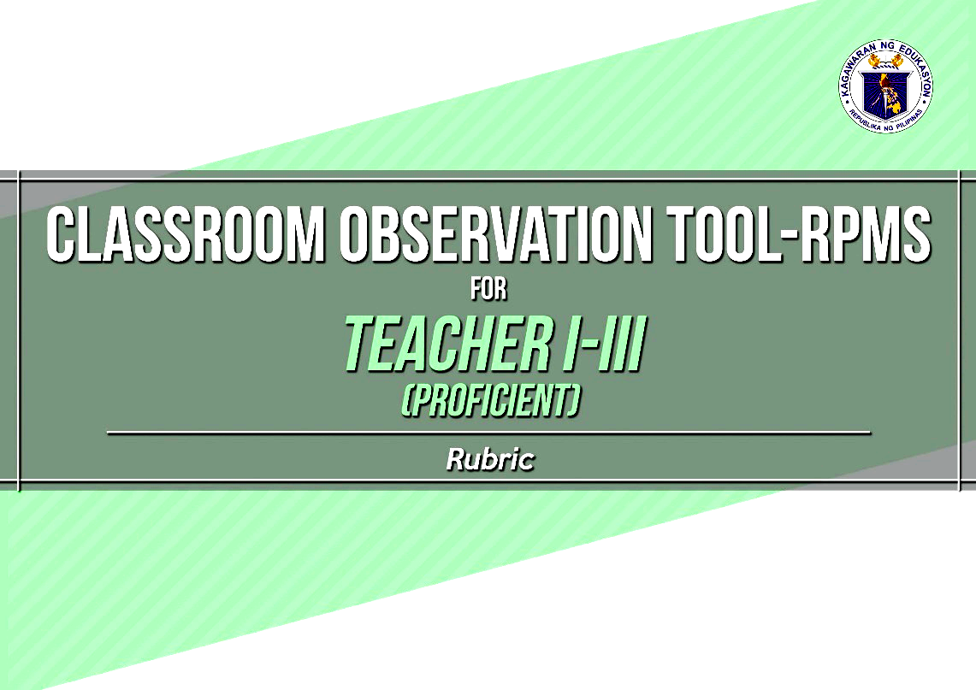

Classroom Observation Tool - RPMS
Notes:
Purpose of the slide: To introduce the new Classroom Observation Tool for RPMS
Notes to the Presenter:
Mention that the new classroom observation tool is PPST-based.
Note that there are two COT for RPMS: one for teachers (Proficient) and another for Master Teachers (Highly Proficient).

Slide 2
FORMS AND TOOLS
FOR CLASSROOM OBSERVATION
Rubric
Indicator List
Observation Notes Form
Rating Sheet
Inter-observer Agreement Form
Notes:
Purpose of the slide: To introduce the tools/forms used in the Classroom Observation Tool-Results-Based Performance Management System (COT-RPMS)
Notes to the Presenter:
Let the participants recall the tools/forms of the COT-RPMS

Slide 3
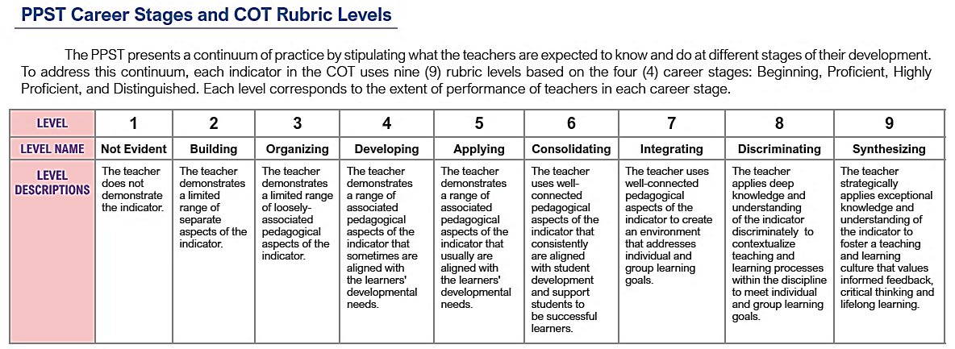
BEGINNING
PROFICIENT
HIGHLY PROFICIENT
DISTINGUISHED
Notes:
Purpose of Slide: To review some features of the Classroom Observation Tool (COT) rubric
Notes to the Presenter:
Emphasize that
The COT rubric addresses the continuum of practice stipulated in the Philippine Professional Standards for Teachers (PPST). Thus, there are 9 rubric levels for each indicator. Levels 1-5 captures the Beginning career stage; levels 3-7 captures the Proficient career stage; levels 4-8 captures the Highly Proficient career stage; and levels 5-9 captures the Distinguished career stage.
For the transition years, DepEd decided on the default career stages: Teachers (Proficient) and Master Teachers (Highly Proficient). Proficient teachers are assessed using rubric levels 3-7 while Highly Proficient teachers are assessed using rubric levels 4-8.
The activities for the capacity building are intended to capacitate the raters on rubric levels 3-8 of the indicators.

Slide 4
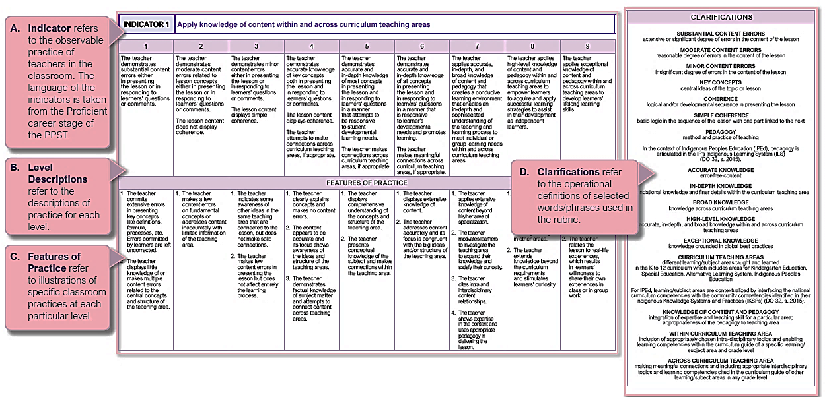
Rubric
Notes:
Purpose of Slide: To review some features of the Classroom Observation Tool (COT) rubric
Note to the Presenter:
1. Note that the parts of the COT rubric are similar to the parts of COT-RPMS rubrics.

Slide 5
Indicator List
NINE (9) INDICATORS IN THE COT RUBRIC FOR PROFICIENT TEACHERS (TI-TIII)
SEVEN (7)HIGHLY PROFICIENT TEACHERS
Notes:
Purpose of the Slide: To orient the participants on the 9 indicators in the COT Rubric for Teachers I-III (Proficient Teachers)
Notes to the Presenter:
Mention that for Proficient Teachers, there are nine (9) indicators that are classroom observable.

Slide 6
Note: For RPMS SY 2021-2022
 | Classroom Observable Objectives | MOV from Classroom Observation | With Set A and B as options
Proficient Teacher | 1,3,4,5,6,7,8,9,10 | 1,3,4,5,6 | 7,8,9 10
Highly Proficient Teacher | 1,3,4,6,7,9,10 | 1,3,4,6,7 | 9,10
Note: Two Observations are required for both
Proficient and Highly Proficient
Indicator List
Notes:
For Proficient Teachers there are 9 observable objectives, 5 require MOV from classroom observation, 4 is with option on A of B;

Slide 7
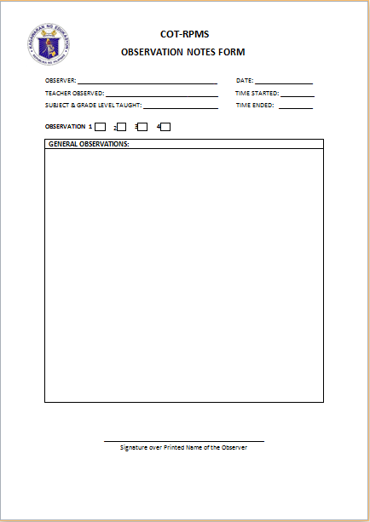
Observation Notes Form
OBSERVER: _________________________________ DATE: ___________
NAME OF TEACHER OBSERVED: _________________ TIME STARTED: _____
SUBJECT AND GRADE LEVEL TAUGHT: _____________ TIME ENDED: _____
OBSERVATION PERIOD: 1 2
Juan Cruz
Jan. 10, 2019
Maria Gomez
10:00 am
11:00 am
English 10
Use to record comments and observations on the teacher’s performance.
P
Notes:
Purpose of the slide: To introduce the Observation Notes Form
Notes to the Presenter:
Emphasize that the needed data should be filled out during the actual observation.

Slide 8
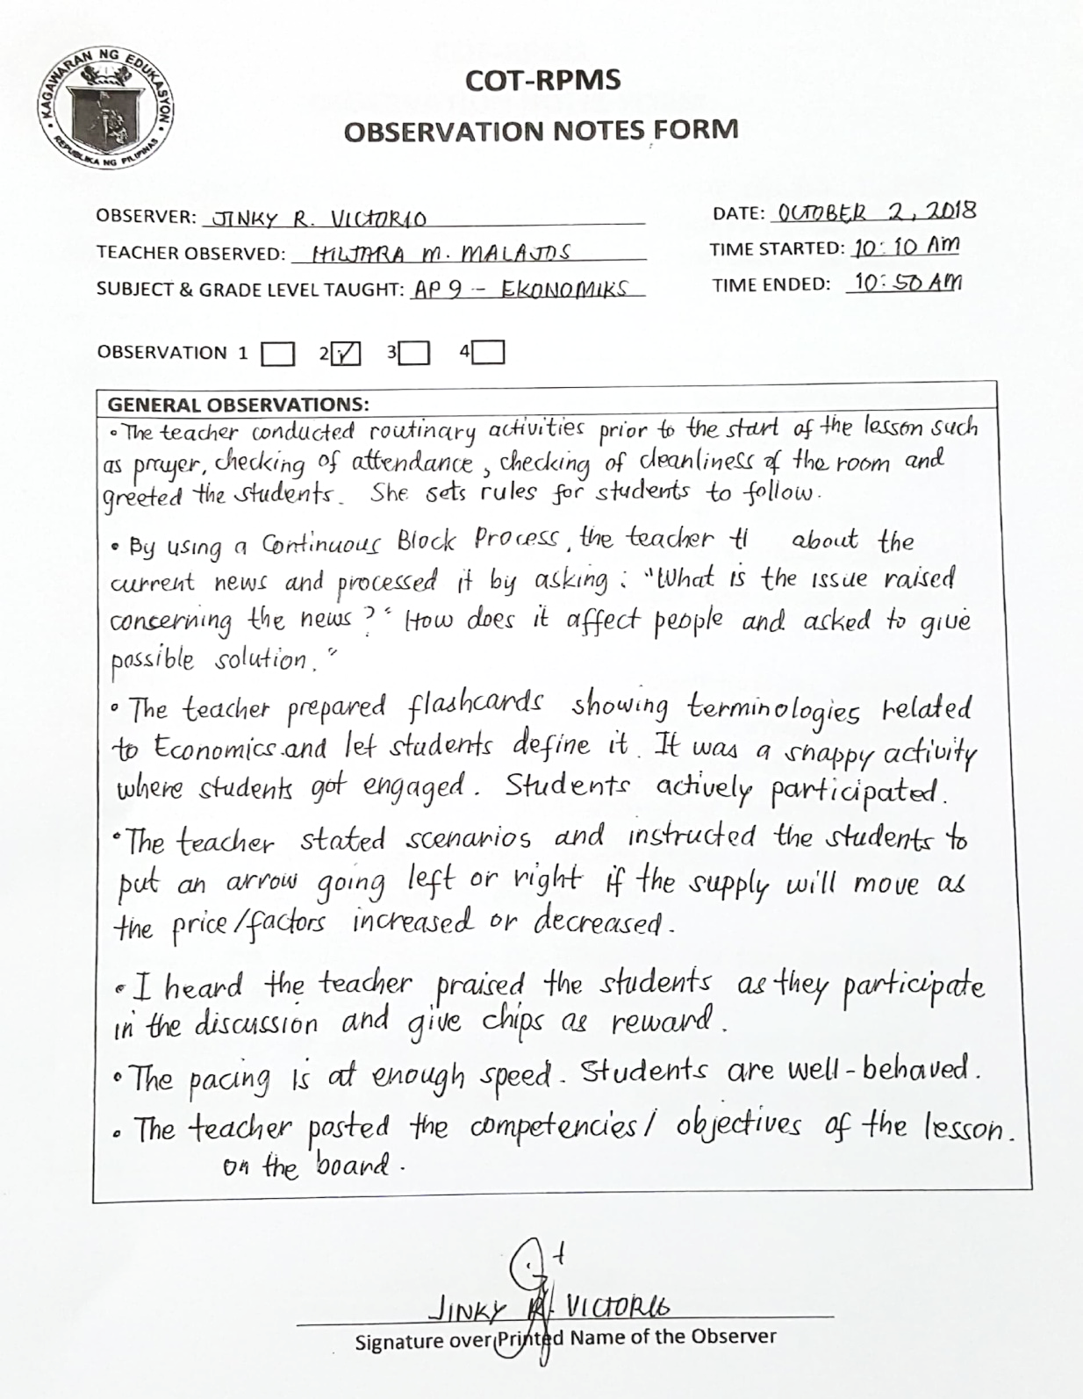
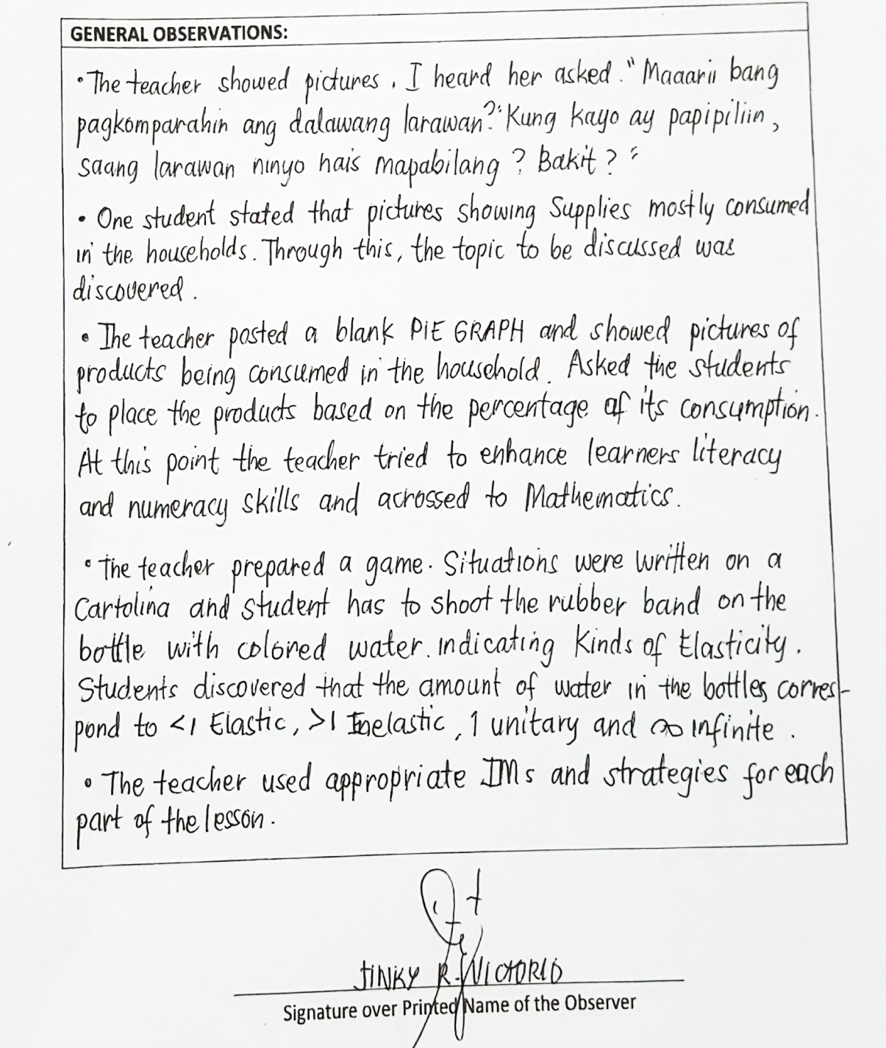
SAMPLE OBSERVATION NOTES
Notes:
Purpose of the slide: To provide a sample Observation Notes Form
Notes to the Presenter:
Present the sample observation notes form.
Note the comments provided by the observer.
Emphasize that observers can refer back to the comments he wrote on the observation notes form when they decide on the rating of the teacher observed on each of the indicators.

Slide 9
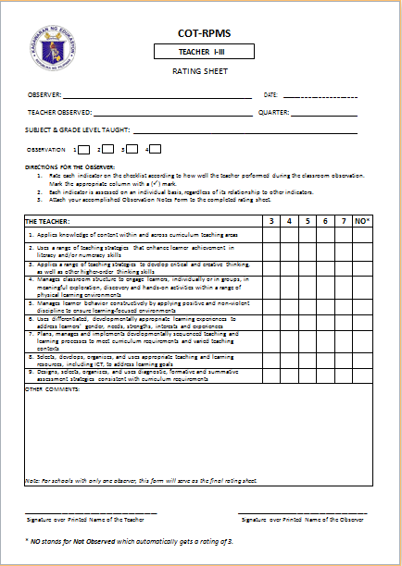
RATING SHEET
Do not bring this form during actual observation.
Refer to your observation notes in rating the teacher observed.
Notes:
Purpose of the slide: To introduce and explain the purpose of the Rating Sheet form
Notes to the Presenter:
Note that this is a sample rating sheet for Teachers I-III (Proficient Teachers).
Emphasize that:
This form is completed after the observation.
In case of multiple observers, this form is to be accomplished individually by the observer before the Inter-Observer Agreement Exercise.
Point out that there is a column for NO or Not Observed for indicators that were supposed to be demonstrated by the teacher, but was not shown during the actual observation. An NO automatically gets a rating of 3 for Proficient Teachers.
Whenever possible, a subject expert is expected to rate indicator 1 (Applies Knowledge of Content within and across curriculum content areas).
Elementary teachers are ‘generalists’, any observer may rate Indicator 1.
If there is only one observer, she/he rates ALL indicators

Slide 10
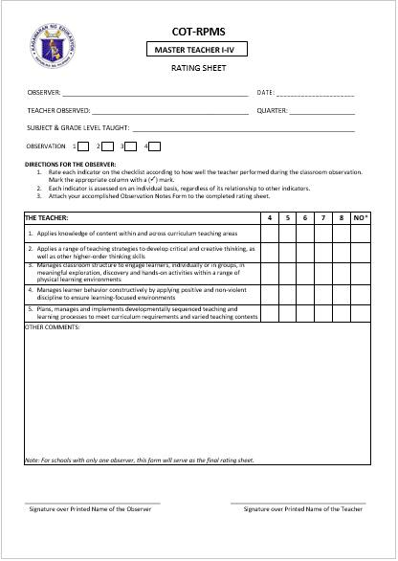
RATING SHEET
Do not bring this form during actual observation.
Refer to your observation notes in rating the teacher observed.
Notes:
Purpose of the slide: To introduce and explain the purpose of the Rating Sheet
Notes to the Presenter:
Note that this is a sample rating sheet for Master Teachers I-IV or Highly Proficient Teachers.
Point out that there is a column for NO or Not Observed for indicators that were supposed to be demonstrated by the teacher, but was not shown during the actual observation. An NO automatically gets a rating of 4 for Highly Proficient Teachers.

Slide 11
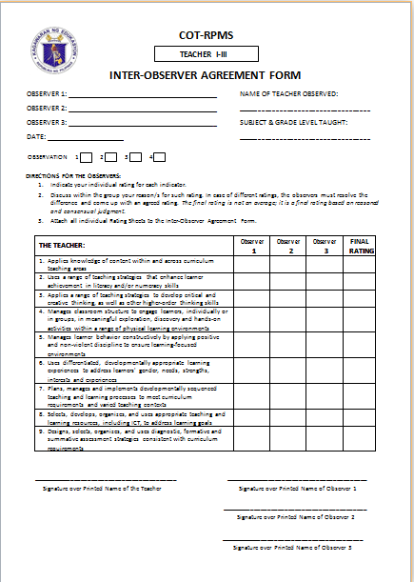
INTER-OBSERVER AGREEMENT FORM
In case of multiple observers
Discuss the rating with fellow observer/s
Arrive at a final rating
The final rating is NOT an average; it is based on reasoned and consensus judgment.
Notes:
Purpose of the slide: To orient the participants on the activities of the observers during the Inter-Observer Agreement Exercise (in case of multiple observers)
Notes to the Presenter:
Explain the illustration:
In case of multiple observers:
All observers meet together after they are done with the Individual Rating Exercise.
In doing the Inter-Observer Agreement Exercise, the observers agree on the final rating they will give the teacher for each indicator. The final rating must be based on reasoned and consensual judgment and NOT on the average of all the ratings given by the observers.
(To average a rating is not appropriate. Example: In indicator 1, a rater gives a rating of 3 while the other gives a rating of 7. Getting the average means that the teacher gets a rating of 5. Level/rating 5, in the rubric, has a different expectation from level 3 and level 10. Hence, the average rating is not a correct representation of the teacher’s performance.)

Slide 12

INTER-OBSERVER AGREEMENT FORM
COT-RPMS
TEACHER I-III
INTER-OBSERVER AGREEMENT FORM
OBSERVER 1: ___________________________________ NAME OF THE TEACHER OBSERVED: OBSERVER 2: ___________________________________ ________________________________________ OBSERVER 3: ___________________________________ SUBJECT & GRADE LEVEL TAUGHT DATE: __________________________________________ ________________________________ OBSERVATION 1 2 3 4
DIRECTIONS FOR THE OBSERVER: 1. Indicate your individual rating for each indicator. 2. Discuss within the group your reason/s for such rating. In case of different ratings, the observers must resolve the difference and come up with an agreed rating. The final rating is not an average; it is a final rating based on reasoned and consensual judgment. 3. Attach all individual Rating Sheets to this Inter-Observer Agreement Form.
THE TEACHER: | Observer 1 | Observer 2 | Observer 3 | FINAL RATING
Applies knowledge of content within and across curriculum teaching areas
Uses a range of teaching strategies that enhance learner achievement in literacy and/or numeracy skills
Applies a range of teaching strategies to develop critical and creative thinking, as well as other higher-order thinking skills
Manages classroom structure to engage learners, individually or in groups, in meaningful exploration, discovery and hands-on activities within a range of physical learning environments
Manages learner behavior constructively by applying positive and non-violent discipline to ensure learning-focused environments
Uses differentiated, developmentally appropriate learning experiences to address learners' gender, needs, strengths, interests and experiences
7. Plans, manages and implements developmentally sequenced teaching and learning processes to meet curriculum requirements and varied teaching strategies
Selects, develops, organizes, and uses appropriate teaching and learning resources, including ICT, to address learning goal
Designs, selects, organizes, and uses diagnostic, formative and summative assessment strategies consistent with curriculum requirements
In case of multiple observers
All observers must write their ratings on the Inter-Observer Agreement Form
The final rating for each indicator must be written under the column Final Rating
(4+4+7)/3= 5
4
5
7
6
5
6
7
4
6
7
5
6
6
6
7
6
6
6
7
5
5
7
6
6
6
7
5
5
The final rating is NOT an average; it is based on reasoned and consensual judgment.
Notes:
Purpose of the slide: To introduce the Inter-Observer Agreement Form
Notes to the Presenter:
In case of multiple observers:
All observers meet together after they are done with the Individual Rating Exercise.
All observers must write their ratings on the Inter-Observer Agreement Form. The final rating for each indicator must be written under the column Final Rating. Emphasize that the final rating must be based on reasoned and consensual judgment and NOT on the average of all the ratings given by the observers.

Slide 13
ALTERNATIVE CLASSROOM OBSERVATION PROCESSES

Slide 14
PRE- OBSERVATION
 | Online Observation and Through Two – Way Radio Instruction | Observation of a Video Lesson or an Audio Lesson | Observation of a Demonstration Teaching Via Learning Action Cell (LAC) | Observation during Limited Face-to-Face Classes in Low –Risk Areas
Observer/s | 1. Review the COT-RPMS rubric appropriate to the position of the teacher to be observed.
Teacher | 2. Review the COT-RPMS rubric appropriate to his/her position.

Slide 15
PRE- OBSERVATION
 | Online Observation and Through Two – Way Radio Instruction | Observation of a Video Lesson or an Audio Lesson | Observation of a Demonstration Teaching Via Learning Action Cell (LAC) | Observation during Limited Face-to-Face Classes in Low –Risk Areas
Observer/s 2. Meet with the teacher to discuss the schedule … | …and the online platform to be used for online observation ; Handheld radio for two –way radio instruction | …of submission of the video or audio lesson | …of the LAC session intended for demonstration teaching | …of the onsite observation

Slide 16
PRE- OBSERVATION
 | Online Observation and Through Two – Way Radio Instruction | Observation of a Video Lesson or an Audio Lesson | Observation of a Demonstration Teaching Via Learning Action Cell (LAC) | Observation during Limited Face-to-Face Classes in Low –Risk Areas
Teacher | Plans the Lesson based on the Indicator
 |  | Delivers the lesson using a video or audio recording device

Slide 17
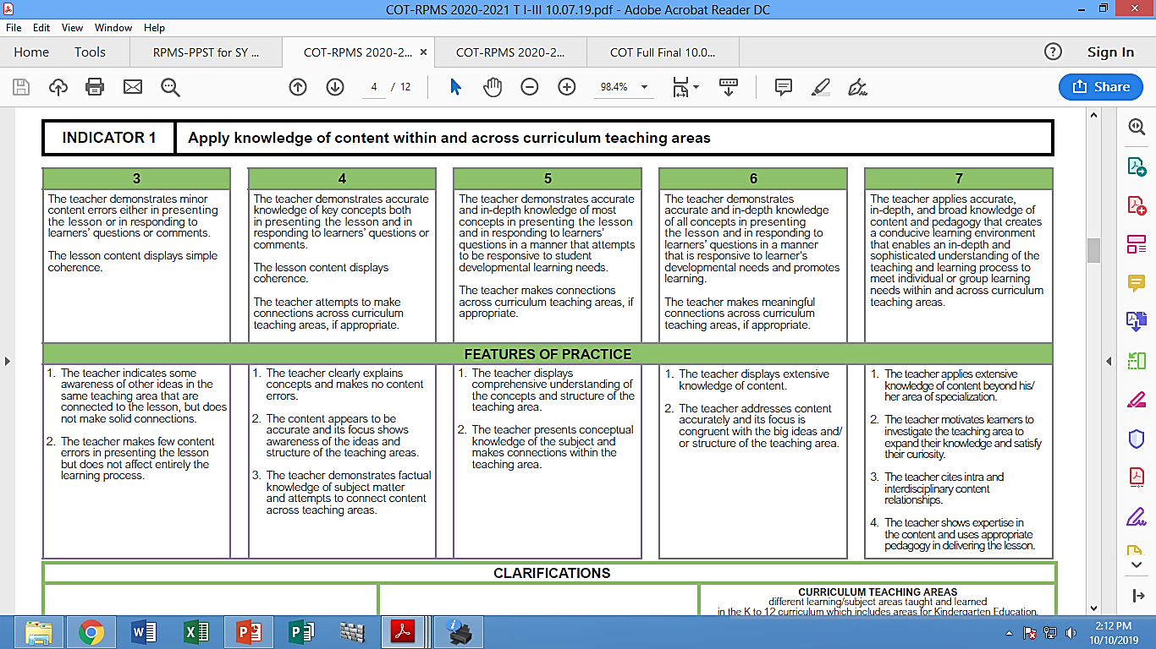
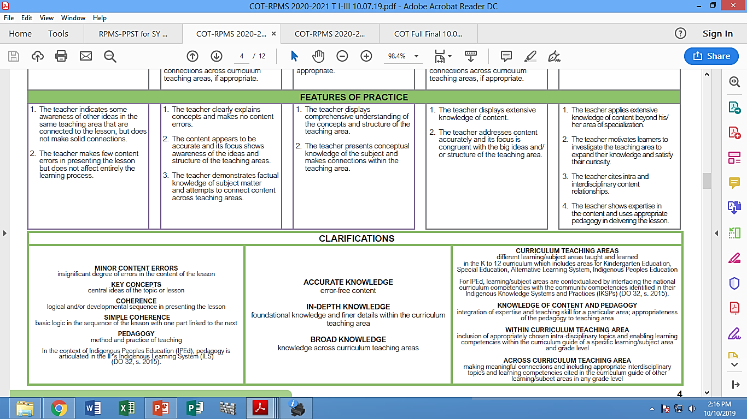

Tools/ Forms Needed
COT- RPMS Rubric
Notes:
Video or audio lesson
Schedule of LAC session
Onsite observation

Slide 18
ACTUAL OBSERVATION
 | Online Observation and Through Two – Way Radio Instruction | Observation of a Video Lesson or an Audio Lesson | Observation of a Demonstration Teaching Via Learning Action Cell (LAC) | Observation during Limited Face-to-Face Classes in Low –Risk Areas
Observer/s | Access the online platform or radio frequency at the scheduled class | View the video lesson to the audio lesson after submission | Sit at any available seats | Sit at any available seats Multiple observers are to sit apart
 | Record all comments on the Observation Notes Form

Slide 19
ACTUAL OBSERVATION
 | Online Observation and Through Two – Way Radio Instruction | Observation of a Video Lesson or an Audio Lesson | Observation of a Demonstration Teaching Via Learning Action Cell (LAC) | Observation during Limited Face-to-Face Classes in Low –Risk Areas
Teacher | Delivers the lesson in the chosen online platform or handheld radio | Submit the video or audio lesson to the obverse/s | Delivers the lesson on the agreed time and location | Delivers the lesson onsite on the agreed time and location
 | Record all comments on the Observation Notes Form

Slide 20
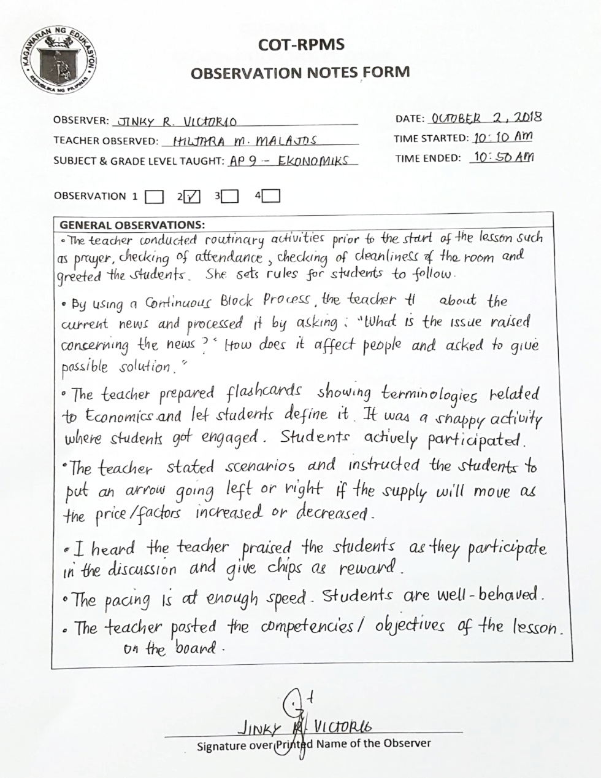
Tools/ Forms Needed
the only form to be brought and completed during the actual observation.
OBSERVATION NOTES FORM

Slide 21
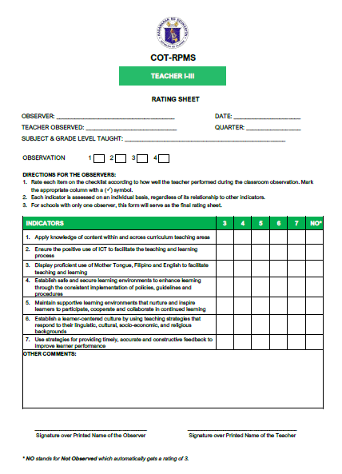
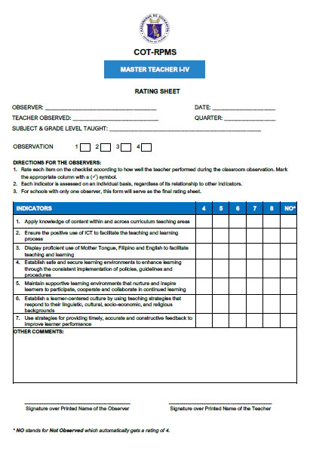
Do not bring this form during actual observation.
Refer to your observation notes in rating the teacher observed.
Notes:
Purpose of the slide: To introduce and explain the purpose of the Rating Sheet
Notes to the Presenter:
EMphasize that:
This form is completed after the observation.
In case of multiple observers, emphasize that this form is to be accomplished individually by the observer before the Inter-Observer Agreement Exercise.
Point out that there is column for NO or Not Observed for indicators that were not observed.

Slide 22





ACTUAL OBSERVATION
If there are multiple observers, avoid engaging in any discussion with one another. Avoid discouraging facial expressions.
Observe the entire class period.
Notes:
Purpose of the slide: To orient the participants on the actual observation activities
Notes to the Presenter:
Emphasize that:
It is highly recommended that the observers stay for the entire period during classroom observation.
It is requested that observers refrain from engaging in any discussion and avoid discouraging facial expressions so teacher won’t be distracted.

Slide 23
INDICATOR LIST FOR PROFICIENT AND HIGHLY PROFICIENT TEACHERS
NO. | INDICATORS | OBSERVATION PERIOD
 |  | 1 | 2 | 3 | 4
1 | Applies knowledge of content within and across curriculum teaching areas | ✓ | ✓ | ✓ | ✓
2 | Ensure the positive use of ICT to facilitate the teaching and learning process | ✓ | ✓ | ✓ | ✓
3 | Display proficient use of Mother Tongue, Filipino and English to facilitate teaching and learning | ✓ | ✓ | ✓ | ✓
4 | Establish safe and secure learning environments to enhance learning through the consistent implementation of policies, guidelines and procedures | ✓ | ✓ | ✓ | ✓
5 | Maintain supportive learning environments that nurture and inspire learners to participate, cooperate and collaborate in continued learning | ✓ | ✓ | ✓ | ✓
6 | Establish a learner-centered culture by using teaching strategies that respond to learners’ linguistic, cultural, socio-economic and religious backgrounds | ✓ | ✓ | ✓ | ✓
7 | Use strategies for providing timely, accurate and constructive feedback to improve learner performance | ✓ | ✓ | ✓ | ✓
If there are multiple observations within a day, it is recommended that an observer undertakes no more than three (3) observation per day.
Note: For RPMS SY 2021-2022, objectives 1,3,4,5 will be observed in all observation periods
Note: It is highly recommended that 2-3 observers participate in the observation, whenever possible.
However, if challenges like schedules and availability of observers hinder a school to follow this recommendation, one (1) observer will be enough.
Notes:
Purpose of the slide: To orient the participants on the pre-observation activities
Notes to the Presenter:
Emphasize that all indicators will be observed in all 4 observation periods.
Clarify that the ideal number of observers is 2-3. However, if this is not possible, one observer will be enough.
Clarify that in case of multiple observations, an observer must undertake no more than 3 observations per day.

Slide 24




POST - OBSERVATION
 | Online Observation and Through Two – Way Radio Instruction | Observation of a Video Lesson or an Audio Lesson | Observation of a Demonstration Teaching Via Learning Action Cell (LAC) | Observation during Limited Face-to-Face Classes in Low –Risk Areas
Observer/s | Rate the Teacher
 | In case of multiple observers Discuss the rating with fellow observer/s Decide on the final rating

Slide 25
POST - OBSERVATION
Rating should be done individually.
If there are multiple observers, the subject specialist/s will rate indicator 1.
Discuss the rating with fellow observer/s.
The final rating is NOT an average; it is the final rating based on reasoned and consensus judgment.

Slide 26
POST - OBSERVATION
If there is only one observer, she/he will rate ALL indicators.
Elementary teachers are generalists; therefore, all observers are expected to rate Indicator 1.

Slide 27
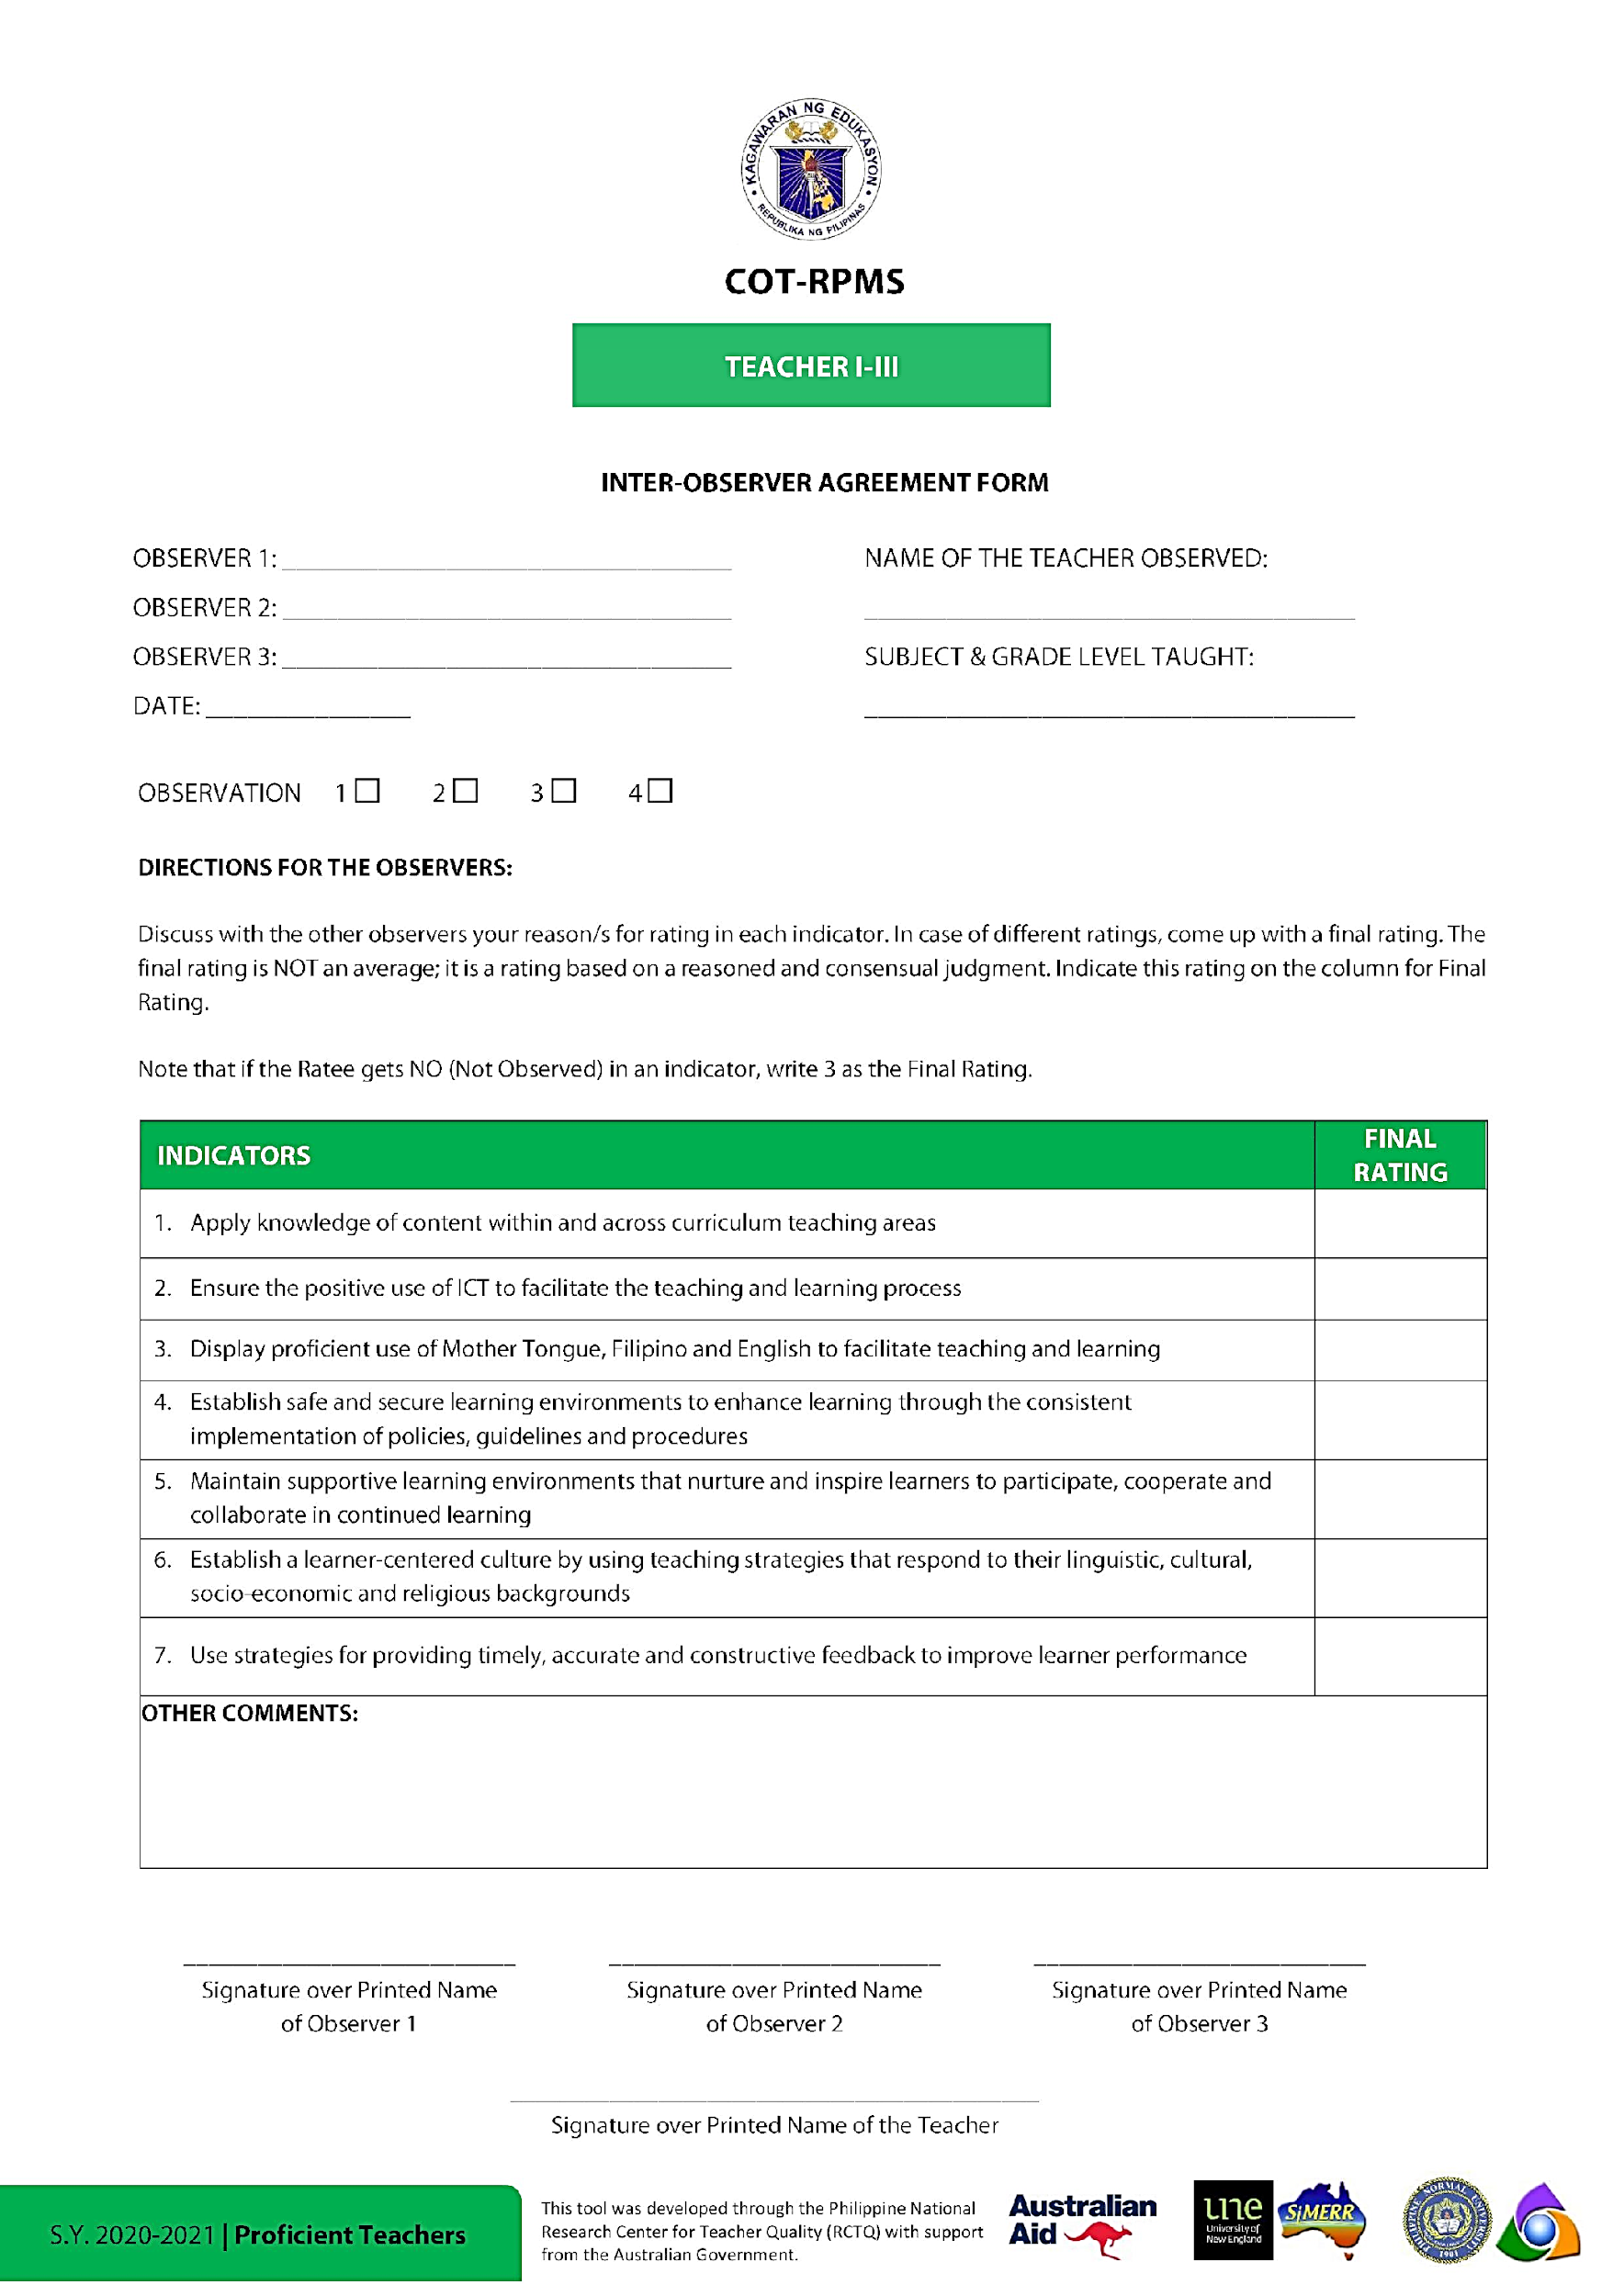
Tools/ Forms Needed
Rating Sheet
Inter-observer agreement

Slide 28
LET’S PRACTICE:
INDICATORS:
1. Apply knowledge of content within and across curriculum teaching areas
2.
3Use effective verbal and non-verbal classroom communication strategies to support learner understanding, participation, engagement and achievement
Display proficient use of Mother Tongue, Filipino and English to facilitate teaching and learning

Slide 29
PRACTICE 1:
OBSERVATION NOTES:
Learner’s were participative in the teaching and learning process.
They showed interest in the lesson .
Congratulations! Carry on!

Slide 30
Tools/ Forms Needed
Rating Sheet
Inter-observer agreement

Slide 31
PRACTICE 2:
OBSERVATION NOTES:
The teacher showed enthusiasm in teaching the lesson.
The use of musical instrument motivated the learners to sing joyfully.
Power point was integrated in the lesson and was used as springboard to further illustrate the lesson.
Teacher gave the options to the learners on what to choose of ways to solve the elapsed time.
All learners were given the chance to recite.
I suggest that you should have called all your learners since they are only 13 and your wide room can accommodate them all.

Slide 32
INDICATORS:
4. Establish safe and secure learning environments to enhance learning through the consistent implementation of policies, guidelines and procedures
5. Maintain learning environments that promote fairness, respect and care to encourage learning
6. Maintain learning environments that nurture and inspire learners to participate, cooperate and collaborate in continued learning 7. Apply a range of successful strategies that maintain learning environments that motivate learners to work productively by assuming responsibility for their own learning

Slide 33
PRACTICE
Linking Observation Notes and the COT Rating
USING OPTION 2
RECORDED VIDEO LESSON OR
AUDIO LESSON
THAT IS SLM –BASED OR MELC -ALIGNED

Slide 34

OBSERVATION
The teacher consistently speaks in English. He uses hand signals and the quality of voice changes. The tone varies during discussion of concept and during entrance of super heroes when introducing another activity.
Indicator no. | INDICATOR | 3 | 4 | 5 | 6 | 7
3 | Use effective verbal and non-verbal classroom communication strategies to support learner understanding, participation, engagement and achievement
COT Score | 3 | 4 | 5 | 6 | 7
RPMS Rating | 1 | 2 | 3 | 4 | 5
(4) RPMS RATING
4
With annotation
Eg. Module, screenshot of instant messaging, note/s showing instructions, narrative

Slide 35
OBSERVATION The use of animated superheroes to introduce different activities (boat is sinking, super driller, brain storm, use of table for common factor, etc,) is engaging and interesting to all learners. It is simple and readily comprehended by the learners.
Though time is not enough for some learners to answer but I heard you say “great/ your really good/ congratulations.
Indicator no. | INDICATOR | 3 | 4 | 5 | 6 | 7
5 | Maintained learning environment that promote fairness, respect, and care to encourage learning
COT Score | 3 | 4 | 5 | 6 | 7
RPMS Rating | 1 | 2 | 3 | 4 | 5
(4) RPMS RATING
3
With annotation
To show ones contribution to the video lesson

Slide 36
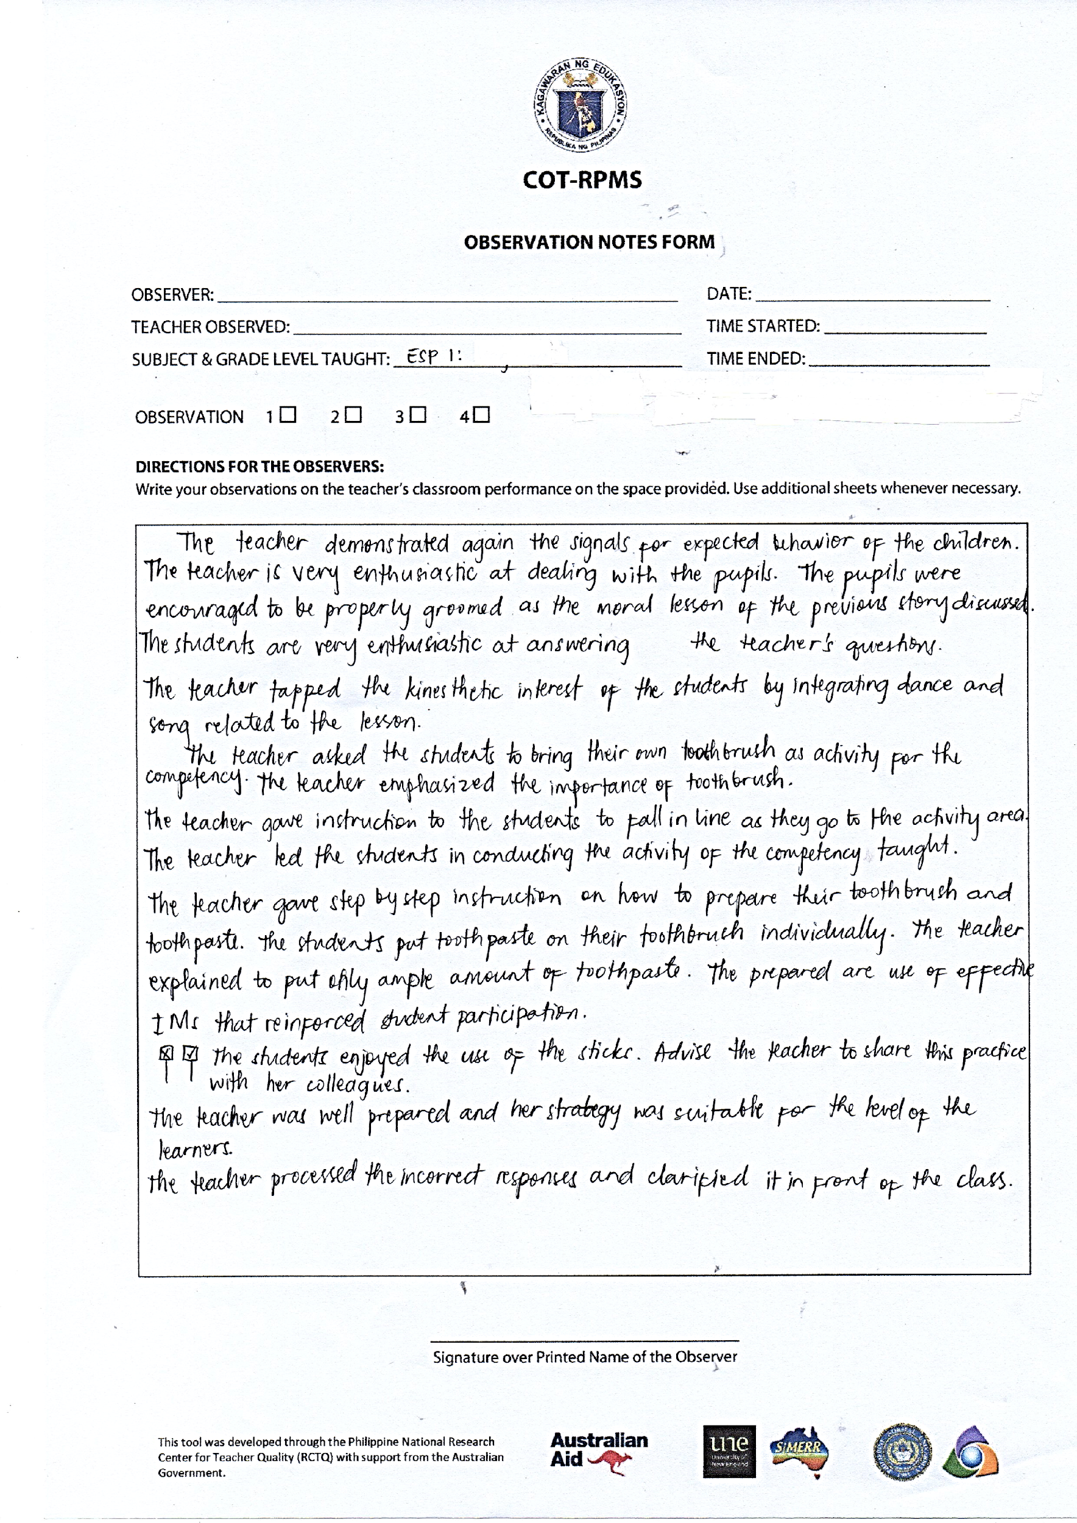
Importance of the Observation Notes
Record teacher performance
Guide observers in rating teacher performance
Provide evidence/basis for coaching and mentoring
Notes:
Purpose of the Slide: To highlight the importance of the classroom observation notes
Notes to the Presenter:
Emphasize that:
Although the observation notes form is not used as MOV for the classroom observable objectives of RPMS, the observation notes, when done properly:
Record teacher performance as it shows during actual teaching in the classroom;
Guide observers in rating the teacher as the notes serve as evidence of performance; and
Provide evidence or basis for coaching and mentoring teachers, especially on indicators that the teacher finds challenging.

Slide 37
Thank You!

