Slide 1
Reviewing RPMS-PPST
Support Materials for Teachers
Notes:
Purpose of the Slide: To show title of slide

Slide 2
PPST Support Materials
Notes:
Purpose of the Slide: To show title of a specific topic in this session

Slide 3
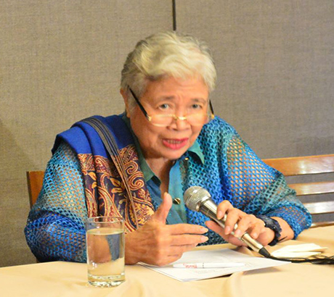
Secretary Briones signed into policy DepEd Order No. 42, s. 2017, The National Adoption and Implementation of the Philippine Professional Standards for Teachers
Notes:
Purpose of the Slide: To provide a rationale of developing the PPST Support Materials for Teachers
Notes to the Presenter:
The inked policy through DepEd Order No. 42 Series 2017 on the National Adoption and Implementation of the PPST serves as the basis for developing the PPST Support Materials.
The strong support of DepEd Secretary becomes the source of strength of the our RCTQ to provide technical assistance to DepEd as process owner of these materials.

Slide 4

DO 42, s. 2017
The policy states, among others, that the PPST “shall be used as a basis for all learning and development programs for teachers.”
Notes:
Purpose of the Slide: To provide a rationale of developing the PPST Support Materials for Teachers
Notes to the Presenter:
It is worthy of note that all learning and development programs for the teachers should be aligned to the expectations of the new standards called the Philippine Professional Standards for Teachers (PPST).
This includes the support materials that will be provided for them.

Slide 5
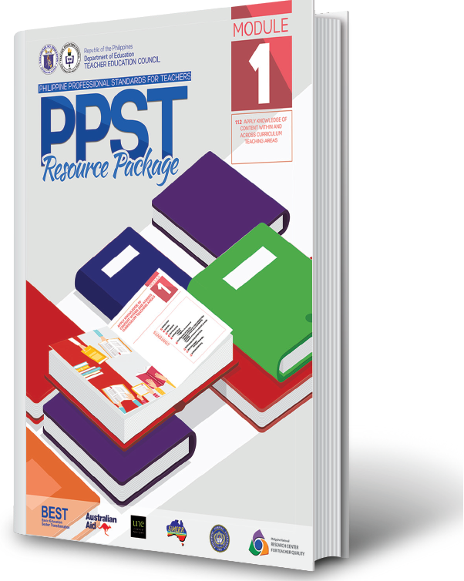
PPST Support Materials
The Department of Education is committed to support teachers’ continuing professional development.
The PPST Support Materials contribute to this commitment.
Notes:
Purpose of the Slide: To provide a rationale of developing the PPST Support Materials for Teachers
Notes to the Presenter:
It is a steadfast commitment of DepEd to capacitate teachers in engaging and meaningful support materials for them to grow and flourish in the teaching profession.
These PPST Support Materials aim to contribute to this commitment. It’s DepEd’s commitment to support teachers in the field.

Slide 6

Stage 1
(Beginning)
Stage 2
(Proficient)
Stage 3
(Highly Proficient)
Stage 4
(Distinguished)
Through the PPST support materials, teachers will be helped what they need to know and be able to do as Proficient Teachers.
Notes:
Purpose of the Slide: To provide a rationale of developing the PPST Support Materials for Teachers
Notes to the Presenter:
1. Emphasize that the aims of developing the PPST Support Materials are:
To help teachers be able to know, be able to do and be able to value in their profession in their profession;
To support teachers in their career progression in a meaningful way from one career stage to another;
To allow teachers to be more creative and innovative in their practices targeting the indicators in a career stage where they are in.

Slide 7
Forms of PPST Support Materials
Print - Resource Package
(24 PPST modules that are based on 24 Proficient career stage indicators)
Non-Print - Videos of Practice
(5 explainer videos that are based on 5 classroom observable Proficient career stage indicators)
Notes:
Purpose of the Slide: To present the forms of PPST Support Materials
Notes to the Presenter:
The print form is the PPST Resource Package which comprises of 24 modules that are based on the 24 Proficient indicators. They are handy and easy to carry. They can also be accessed and download from the DepEd website.
The first 12 modules were already rolled out and used the previous school year.
The non-print form comprises of 5 videos of practice that are based on the 5 classroom observable indicators of the Proficient Career Stage.

Slide 8













24 PPST Modules
Notes:
Purpose of the Slide: To present the 24 PPST Modules
Notes to the Presenter:
The print form is the PPST Resource Package which comprises of 24 modules aligned to 24 Proficient indicators. They are handy and easy to carry. They can also be accessed and downloaded from the DepEd website.
The first 12 modules were already rolled out and used in the school year 2018-2019 and 2019-2020.
Emphasize that all 24 modules will be given to you via a Google Drive link together with all the tools for SY 2020-2021 and other support materials used since Year 1 implementation.

Slide 9





The PPST Modules
Support materials;
Not prescriptive
Teachers’ reference materials
Materials for school-based Learning Action Cell (LAC) sessions
Mentoring materials
Teaching exemplars of Proficient Teachers
Notes:
Purpose of the Slide: To introduce the 24 PPST modules
Notes to the Presenter:
Emphasize that the PPST modules:
serve as reference materials of good teaching practice.
can be used in your learning community, such as LAC Sessions.
are teaching exemplars.
2. Note that the modules are intended to be suggestive, non-prescriptive and stand-alone.

Slide 10
What can teachers expect to find in each module?
You will discover that each module:
discusses a specific indicator;
defines its key concepts; and
provides relevant illustrations of practice that may help you (teachers) understand and attain this indicator.
Notes:
Purpose of the Slide: To present the 24 PPST Modules
Notes to the Presenter:
1. Emphasize that
Each modules discusses a specific indicator;
Key concepts will be unpacked for better understanding of meaning and alignment of terminology.
Each module provides illustration of practice so teachers will be provided with more ideas what, how and why we teach the lesson to the learners.
These practices are aligned to a particular indicator.

Slide 11
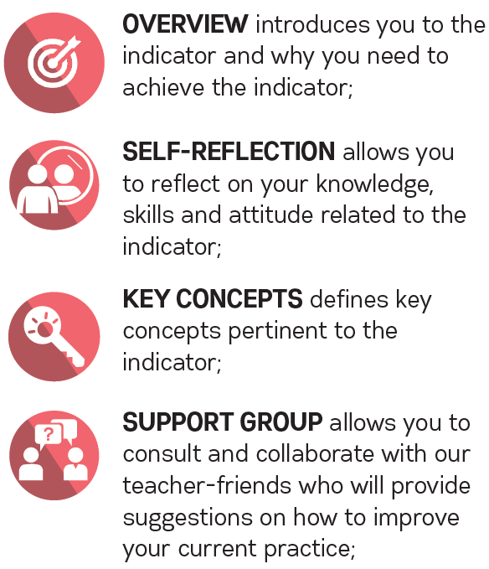
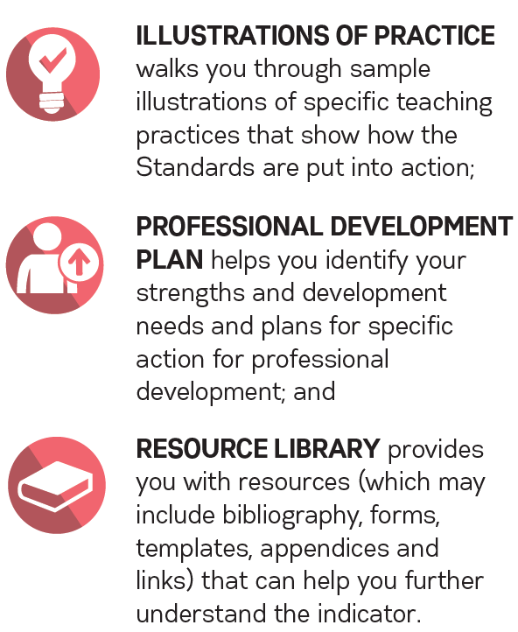
Each module contains the following parts:
Notes:
Purpose of the Slide: To present the features of the 24 PPST Modules
Notes to the Presenter:
Read the slide.

Slide 12
Each module contains the following parts:
Notes:
Purpose of the Slide: To present the features of the 24 PPST Modules
Notes to the Presenter:
Read the slide.

Slide 13
Each module contains the following parts:
Notes:
Purpose of the Slide: To present the features of the 24 PPST Modules
Notes to the Presenter:
Read the slide.

Slide 14
Each module contains the following parts:
Notes:
Purpose of the Slide: To present the features of the 24 PPST Modules
Notes to the Presenter:
Read the slide.

Slide 15
Each module contains the following parts:
Notes:
Purpose of the Slide: To present the features of the 24 PPST Modules
Notes to the Presenter:
Read the slide.

Slide 16
Each module contains the following parts:
Notes:
Purpose of the Slide: To present the features of the 24 PPST Modules
Notes to the Presenter:
Read the slide.

Slide 17
Each module contains the following parts:
Notes:
Purpose of the Slide: To present the features of the 24 PPST Modules
Notes to the Presenter:
Read the slide.

Slide 18
PPST Videos of Practice
Teaching practices shown are suggestive and non-prescriptive.
They “tell” and “show” good teaching practices.
They may guide DepEd teachers in their quest for professional advancement with increasing levels of knowledge, practice and professional engagement.
They support self-reflection and provide access to observation of Proficient Teachers’ practice anytime, anywhere.
Notes:
Purpose of the Slide: To present the features of the PPST Videos of Practice
Note to the Presenter:
Emphasize that the PPST videos of practice intends to show good teaching practices which may serve as models for teachers.

Slide 19
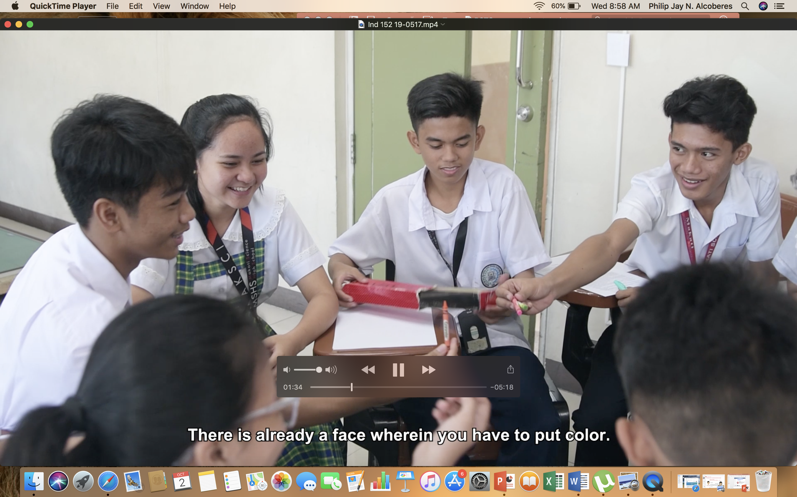
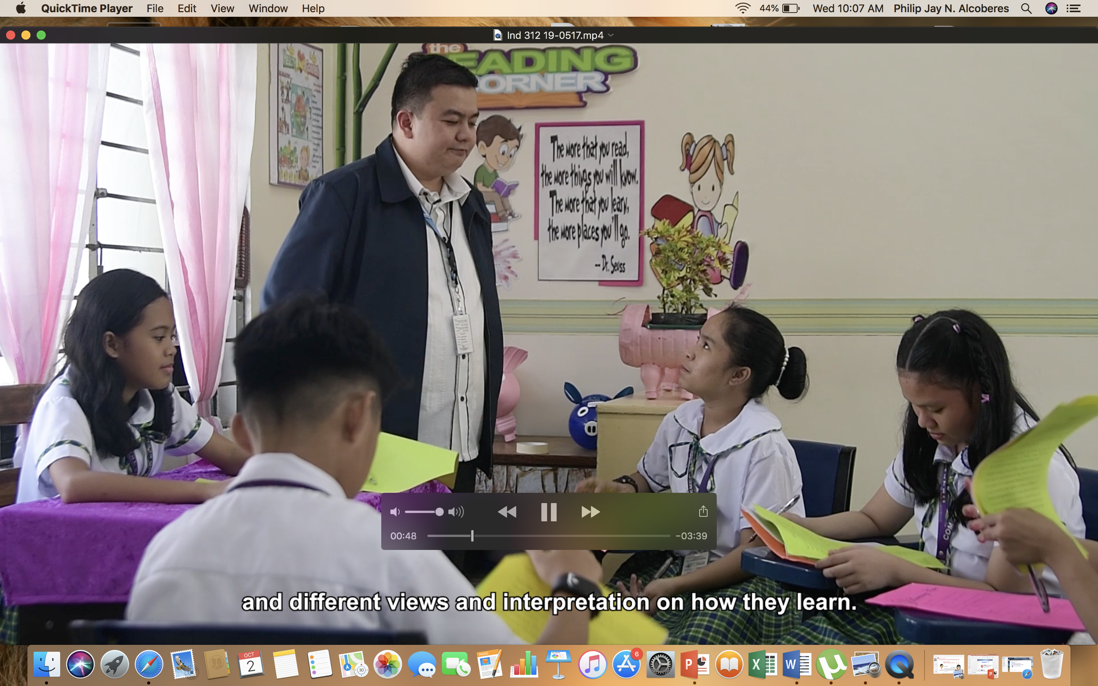
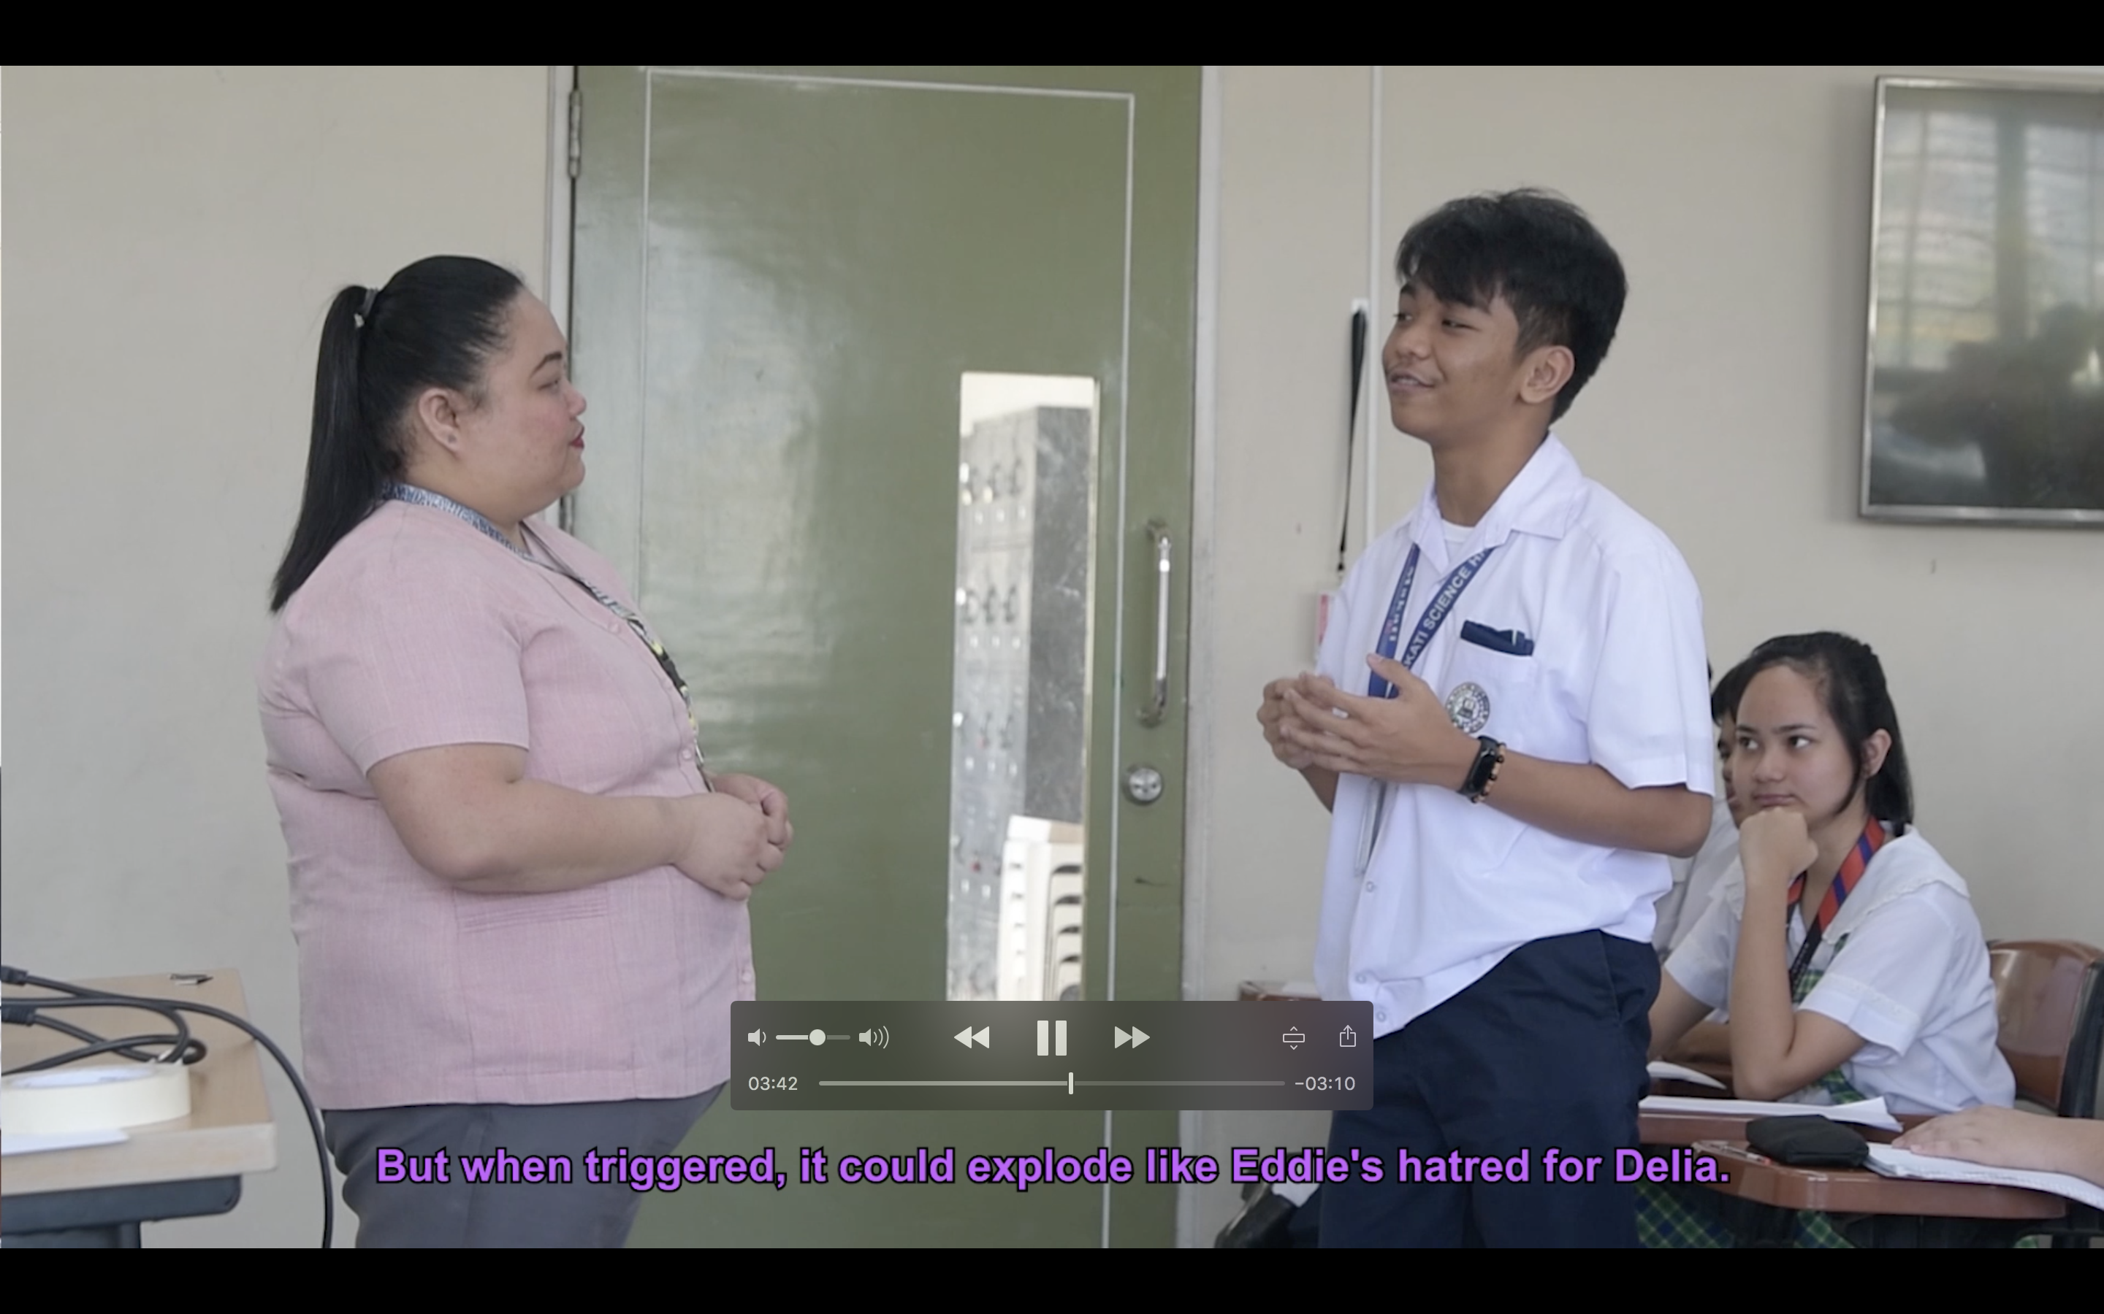
Indicators featured in the PPST Videos of Practice
Video 1 > 1.4.2 Use a range of teaching strategies that enhance learner achievement in literacy and numeracy skills
Video 2 > 1.5.2 Apply a range of teaching strategies to develop critical and creative thinking, as well as other higher-order thinking skills
Video 3 > 2.3.2 Manage classroom structure to engage learners, individually or in groups, in meaningful exploration, discovery and hands-on activities within a range of physical learning environments
Notes:
Purpose of the Slide: To present the indicators featured in the PPST Videos of Practice
Notes to the Presenter:
Enumerate the indicators used in the Videos of Practice.
Emphasize that VIDEO 2 (1.5.2) can be used by Teacher I-III as reference for RPMS SY 2020-2021.

Slide 20
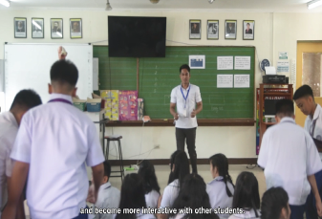
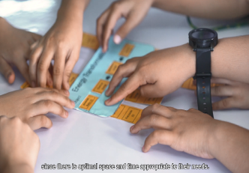
Indicators featured in the PPST Videos of Practice
Video 4 > 3.1.2 Use differentiated, developmentally appropriate learning experiences to address learners' gender, needs, strengths, interests and experiences.
Video 5 > 4.5.2 Select, develop, organize and use appropriate teaching and learning resources, including ICT, to address learning goals
Notes:
Purpose of the Slide: To present the indicators featured in the PPST Videos of Practice
Notes to the Presenter:
Enumerate the indicators used in the Videos of Practice.
Emphasize that VIDEO 5 (4.5.2) can be used by Teacher I-III as reference for RPMS SY 2020-2021.
Remind them that the videos of practice that can be shown in their LAC session or can be viewed on their own.

Slide 21
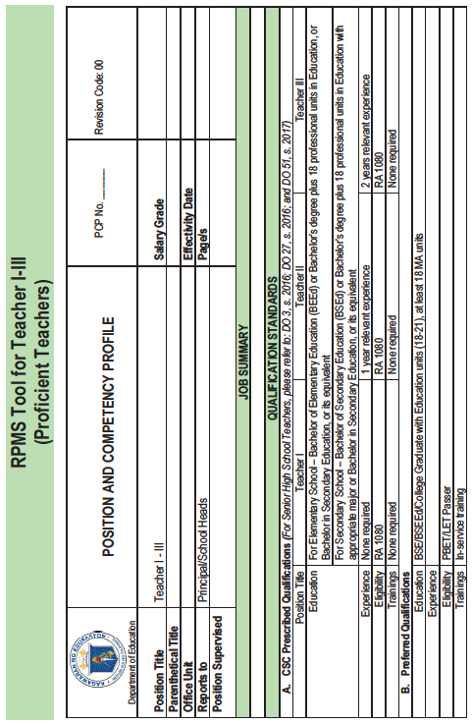
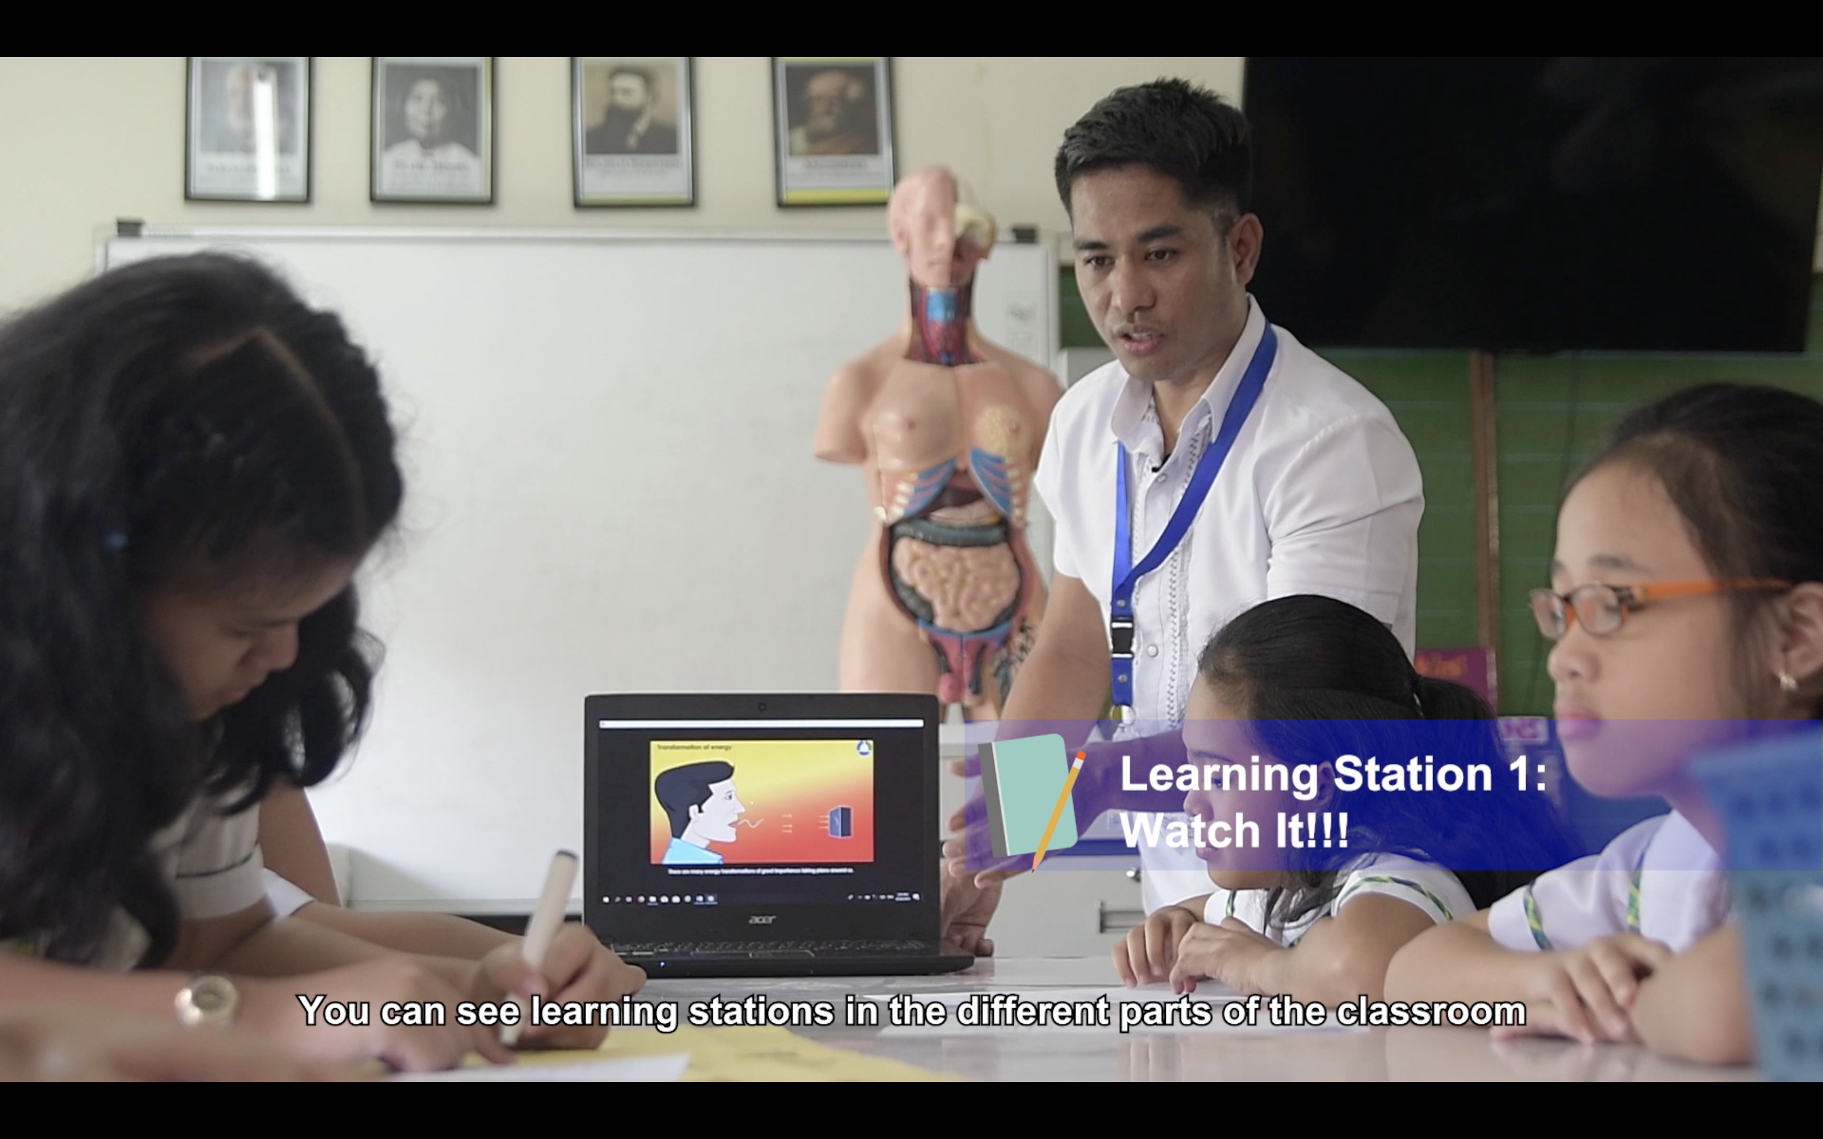
Notes:
Purpose of the Slide: To summarize the main purpose of the PPST support materials
Note to the Presenter:
The pictures above tell them that the support materials such as the PPST Modules and the Videos of Practice may help them understand better the PPST and its link to RMPS.

Slide 22
How can the support materials help teachers in understanding PPST?
The teaching practices shown are illustrative and instructive information. They are aligned to th 24 indicators that are found in the PPST-RPMS.
Teachers can strive and thrive in their teaching practices for career progression.
The support materials may also encourage creativity and innovation to achieve thetarget indicator at the certain level (in COT).
Notes:
Purpose of the Slide: To summarize the main purpose of the PPST support materials
Notes to the Presenter:
1. To summarize, these support materials were developed:
To capacitate teachers by providing them with illustrative and instructive information about the teaching practices specifically targeting an indicator.
To help them grow and flourish in their teaching profession.
To allow them to be more creative and innovative in teaching their learners.

Slide 23
RPMS-PPST Support Materials
Notes:
Purpose of the Slide: To show title of a specific topic in this session

Slide 24
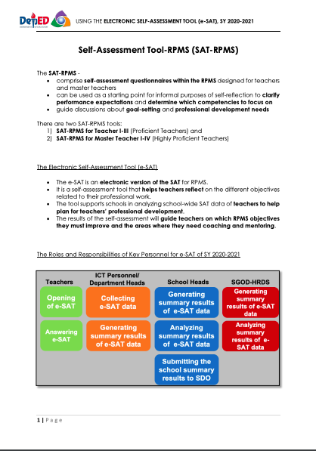
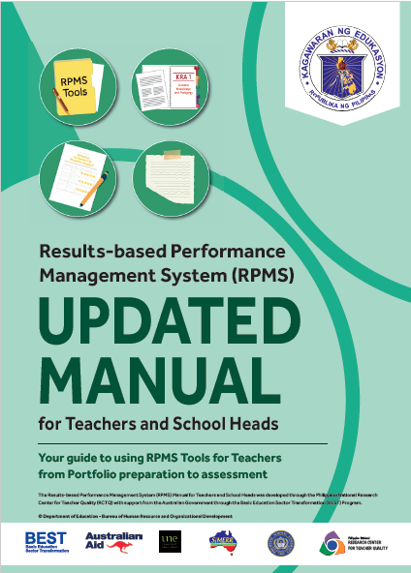
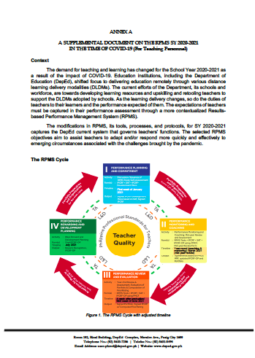
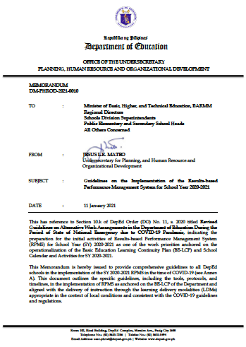

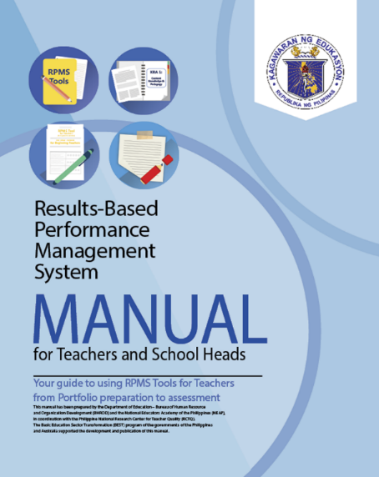

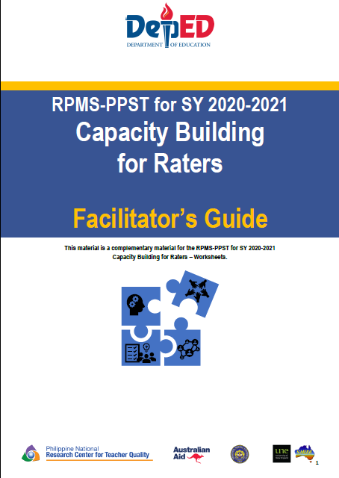
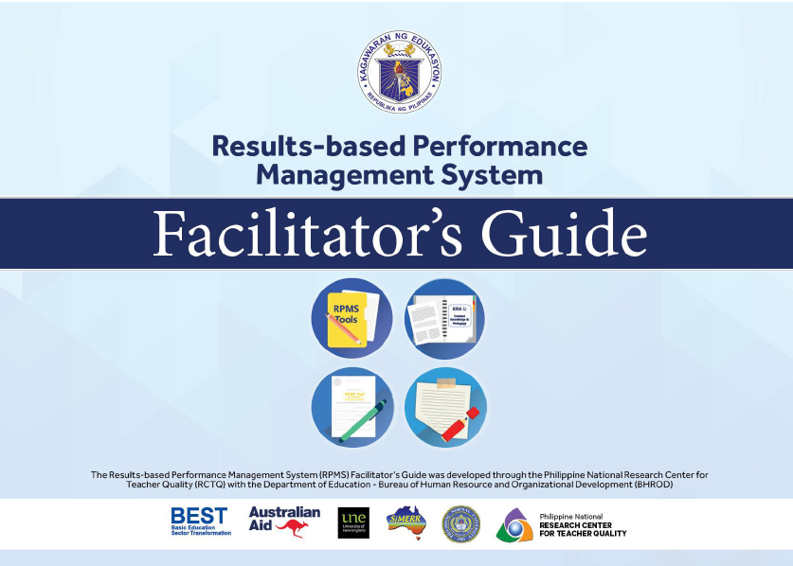
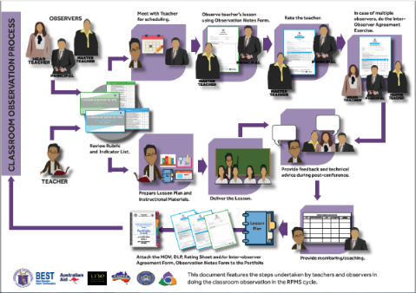
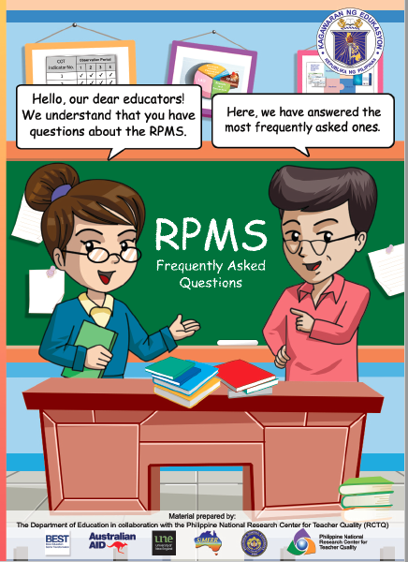
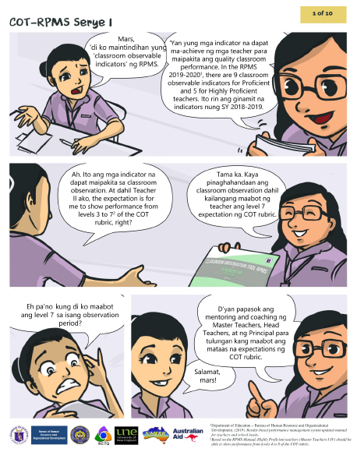
RPMS-PPST Support Materials
e-SAT and
IPCRF Guides
Supplemental Document to DM-PHROD-2021-0010
RPMS Manual
Capacity Building for Raters Resource Package
FAQs and Infographics
RPMS Facilitator’s Guide
Notes:
Purpose of the Slide: To show title of a specific topic in this session

Slide 25
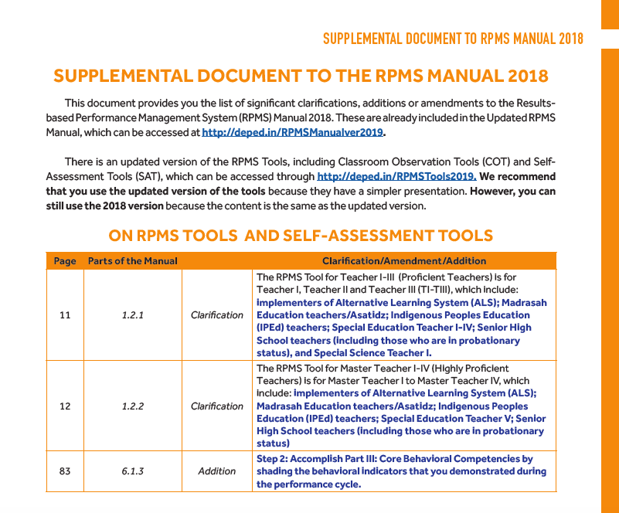

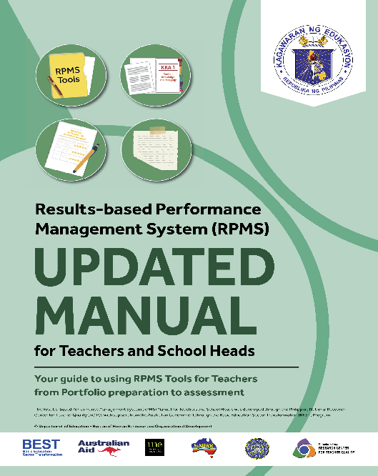
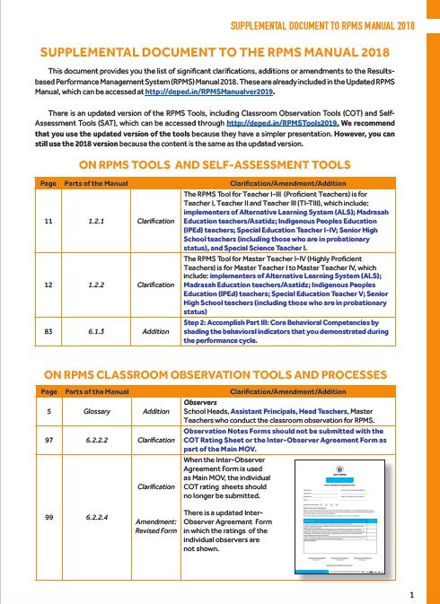
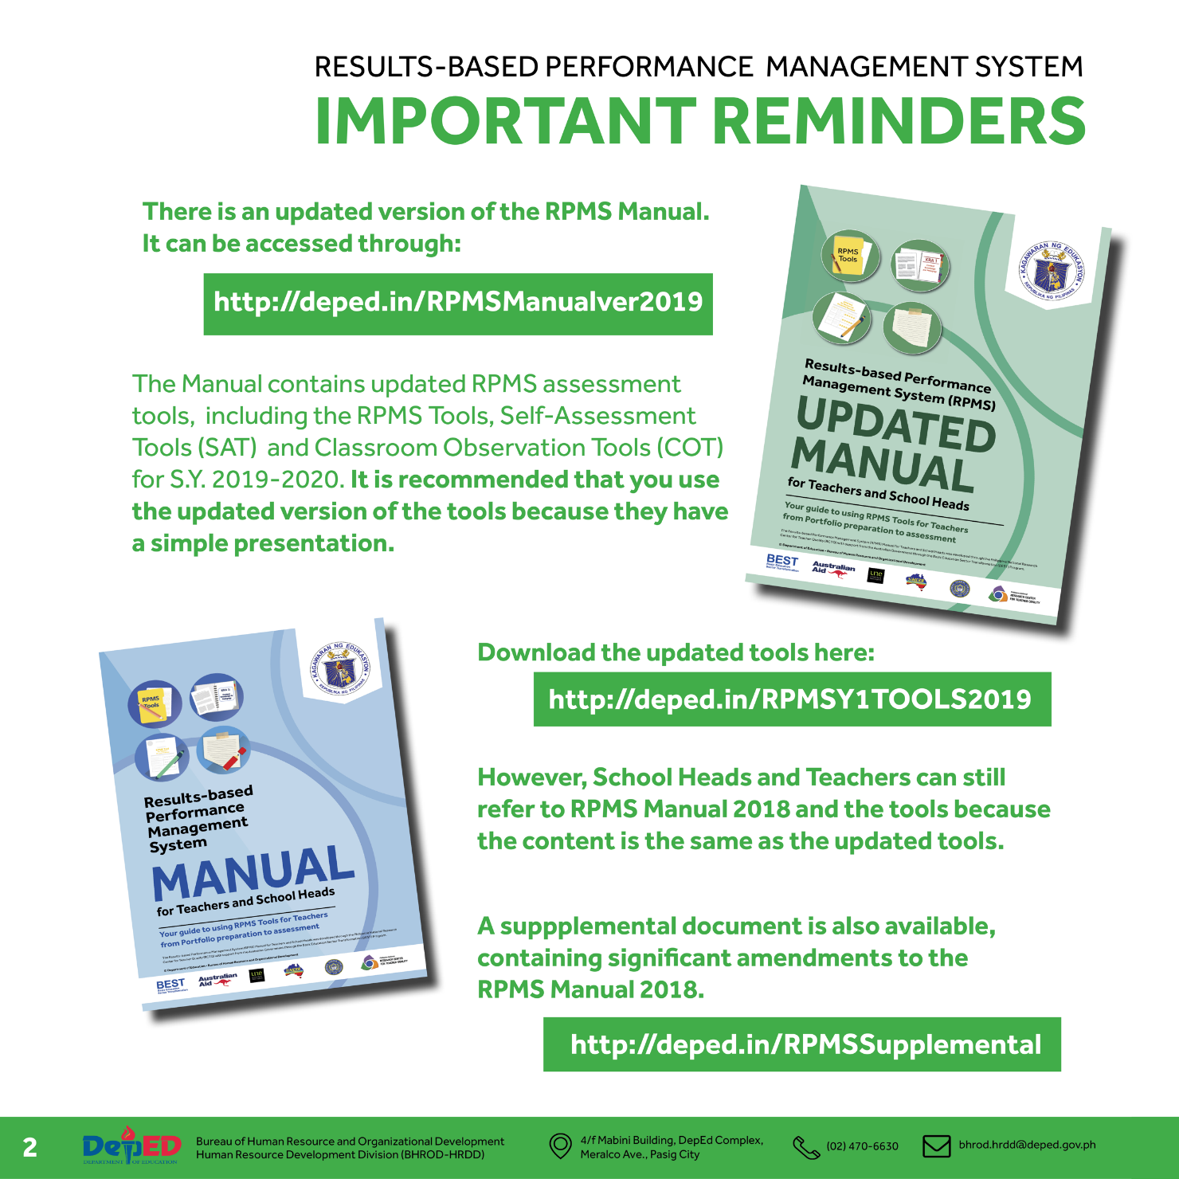
Updated RPMS Manual
Notes:
Purpose of the Slide: To present the versions of the RPMS Manual
Notes to the Presenter:
There are two versions of the RPMS Manual.
The first version is the RPMS Manual version 2018 (blue) with the supplemental document. The supplemental document is intended to provide clarifications and/or amendments in the contents of the manual.
The second version is the RPMS Manual version 2019 (green) or the Updated RPMS Manual. This version already covers the clarifications/amendments in the 2018 version of the manual.

Slide 26

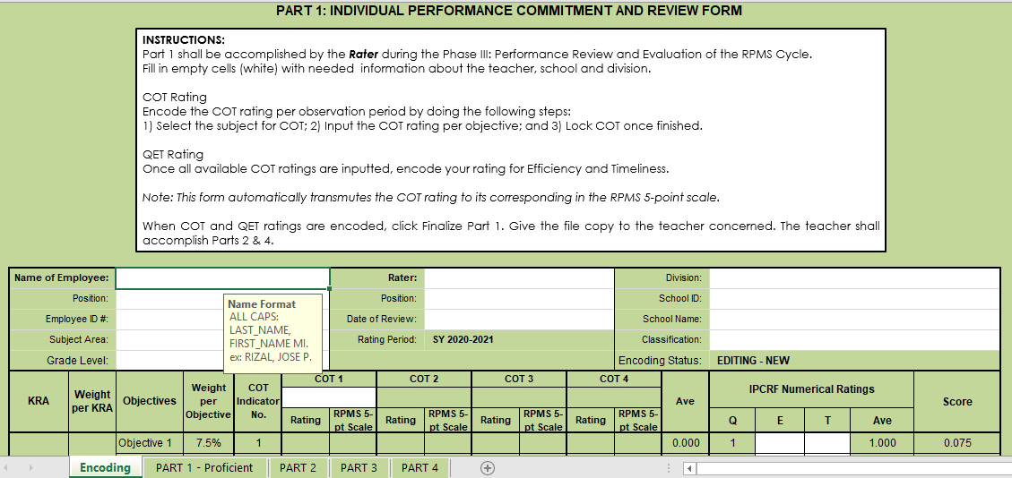
IPCRF Data Collection
and Consolidation Guide
Notes:
Purpose of the Slide: To present IPCRF Data Collection and Consolidation Guide

Slide 27
RPMS-PPST Capacity Building for Raters
Resource Package
This package contains:
Worksheets
Facilitator’s Guide
Slide Presentations
Workshop Videos
Sample Portfolios
Program
Raters can use this material to deepen their understanding of the PPST indicators.
Notes:
Purpose of the slide: To introduce the capacity building resource package
Notes to the Presenter:
Emphasize that the capacity building for raters resource package consists of the worksheets and the facilitator’s guide. Raters can use this material to deepen their understanding of the PPST indicators.
Note that the facilitator’s guide is a complementary material for the worksheets. It contains the answer key to the capacity building worksheets.
Say that the link to the entire capacity building resource package used for this rollout of RPMS-PPST for SY 2020-2021 can be accessed through the link posted on the slide.
Emphasize that aside from the worksheets and facilitator’s guide, the package also contains slide presentations, videos, sample portfolios, and program in case a department/school/district/division/region would like to hold a training.

Slide 28
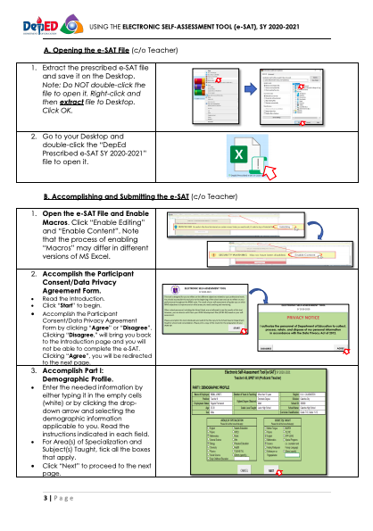
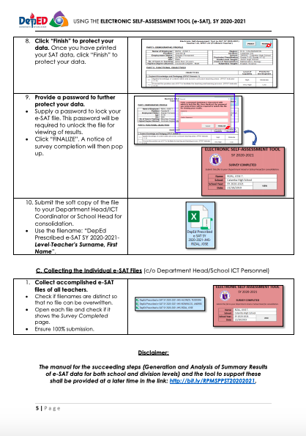
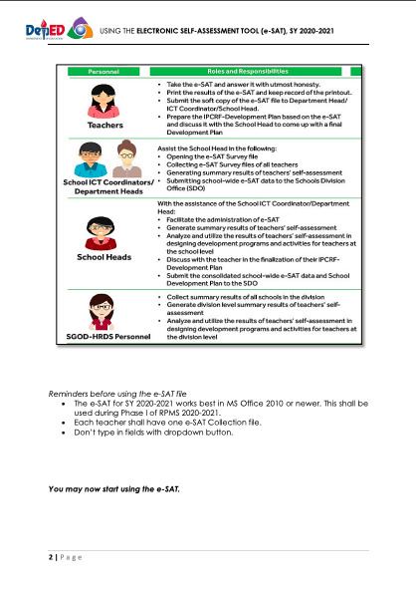
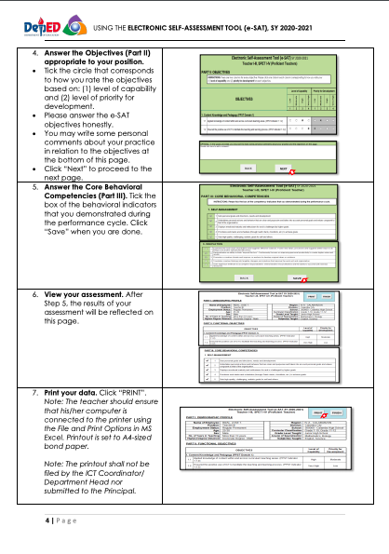
E-SAT Guides
Notes:
Purpose of the Slide: To present the e-SAT Guides

Slide 29
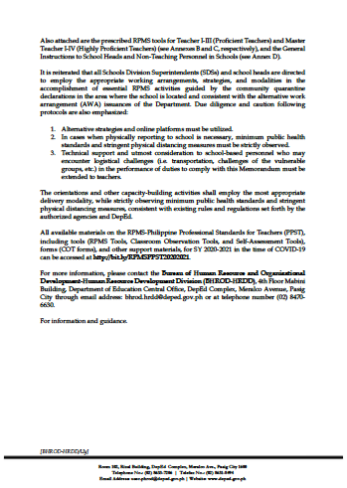
Supplemental Document to the Guidelines on RPMS SY 2020-2021 in the Time of COVID-19 (DM-PHROD-2021-0010)
Notes:
Purpose of the Slide: To present the Guidelines on RPMS for SY 2020-2021

Slide 30

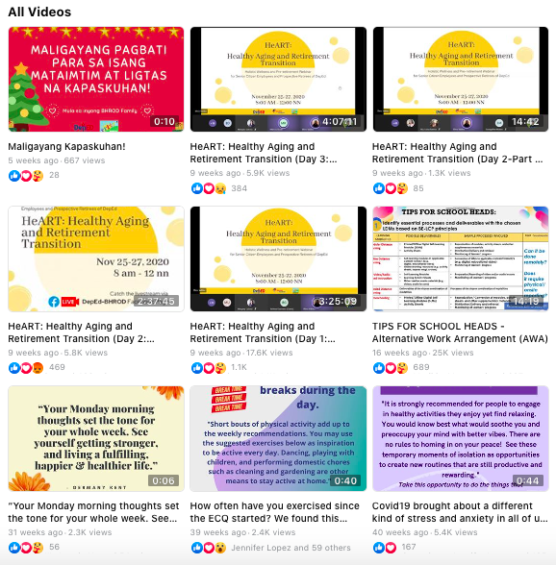
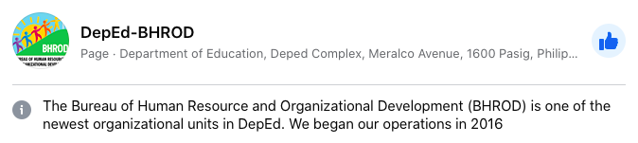
DepEd-BHROD Facebook Page
Notes:
Purpose of the Slide: To present DepEd-BHROD Facebook page where teachers can send their queries/concerns/feedback

Slide 31
RPMS Facilitator’s Guide
Notes:
Purpose of the Slide: To present the Facilitator’s Guide
Notes to the Presenter:
The RPMS Facilitator’s Guide contains the slide decks used in RPMS rollout for 2019-2020 with notes to the presenter. This is still useful for orienting teachers who are new to RPMS-PPST.

Slide 32
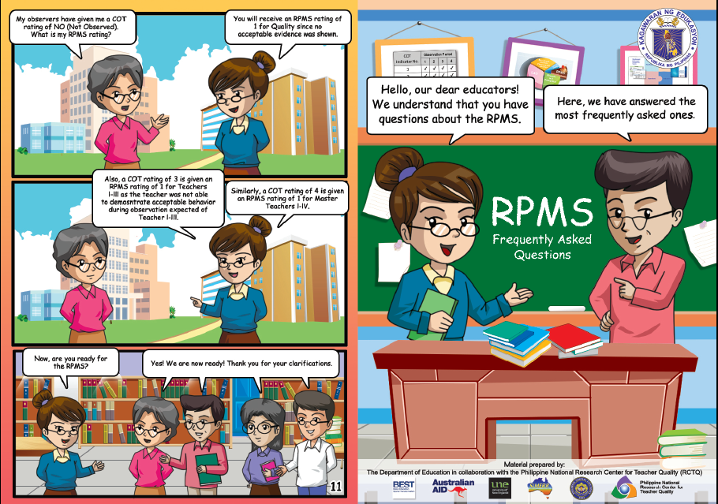

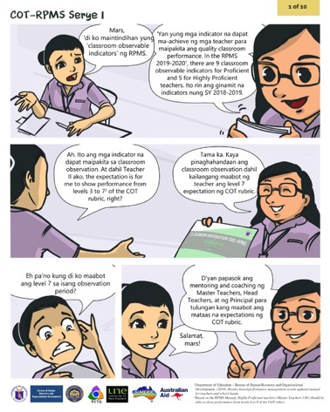
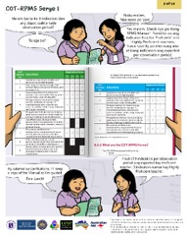
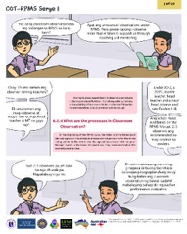
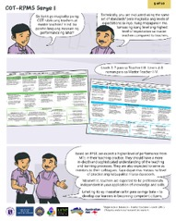
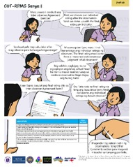
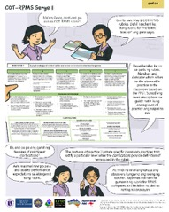
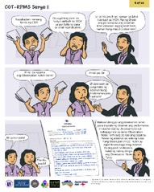
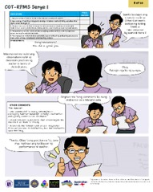
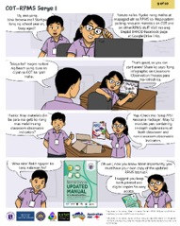
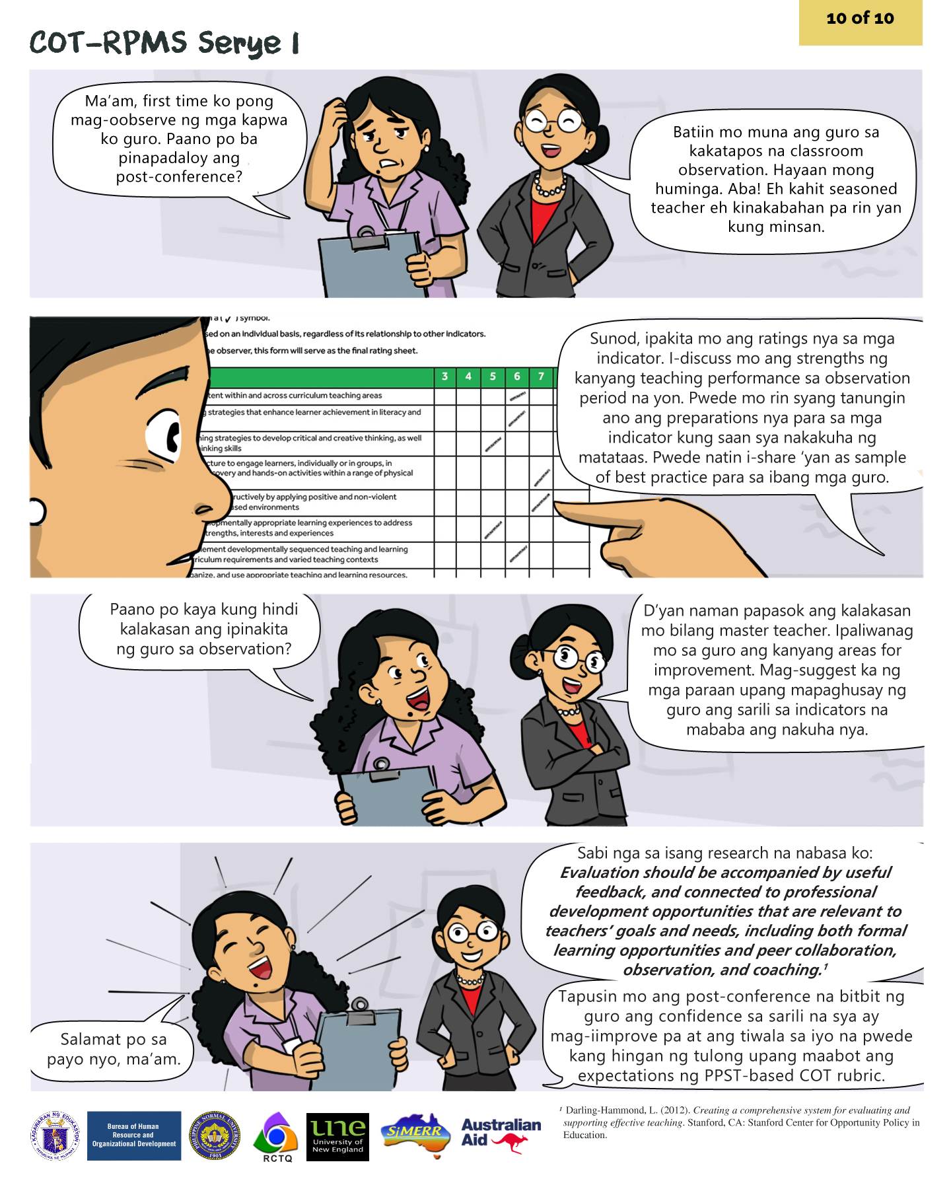
FAQs & Infographics
RPMS General FAQs
Classroom Observation
Process Infographic
COT-RPMS Serye FAQs on Observation
Notes:
Purpose of the Slide: To present the other support materials
Notes to the Presenter:
The RPMS FAQs is a comics that answers the frequently asked questions on RPMS.
The infographic shows the process in conducting classroom observation.
The COT-RPMS Serye is a comics series intended to clarify issues and concerns related to the protocols, tools, and forms used in classroom observation.

Slide 33
Questions?
Notes:
Purpose of the Slide: To prompt participants to ask questions/raise concerns

Slide 34
Contact Us
Bureau of Human Resource and Organizational Development-Human Resource Development Division (BHROD-HRDD)
bhrod.hrdd@deped.gov.ph
Ma. Paula Bianca Manas
Project Development Officer III
ma.manas@deped.gov.ph
Cecille Anyayahan
Project Development Officer IV
cecille.anyayahan@deped.gov.ph

Slide 35
Presentation Slides prepared by
Dr. Philip Jay N. Alcoberes, RCTQ Senior Program Manager
alcoberes.pjn@pnu.edu.ph
Angelo D. Uy, BHROD-HRDD
angelo.uy@deped.gov.ph
Contact Us
Phone +63 2 53171768 Local 763/764
Telefax +63 2 53369755
Web http://www.rctq.ph/
Email rctq@pnu.edu.ph

