Slide 1
Understanding the RPMS
SY 2020-2021 in the time of COVID-19
Notes:
Purpose of the slide: To show title of presentation

Slide 2
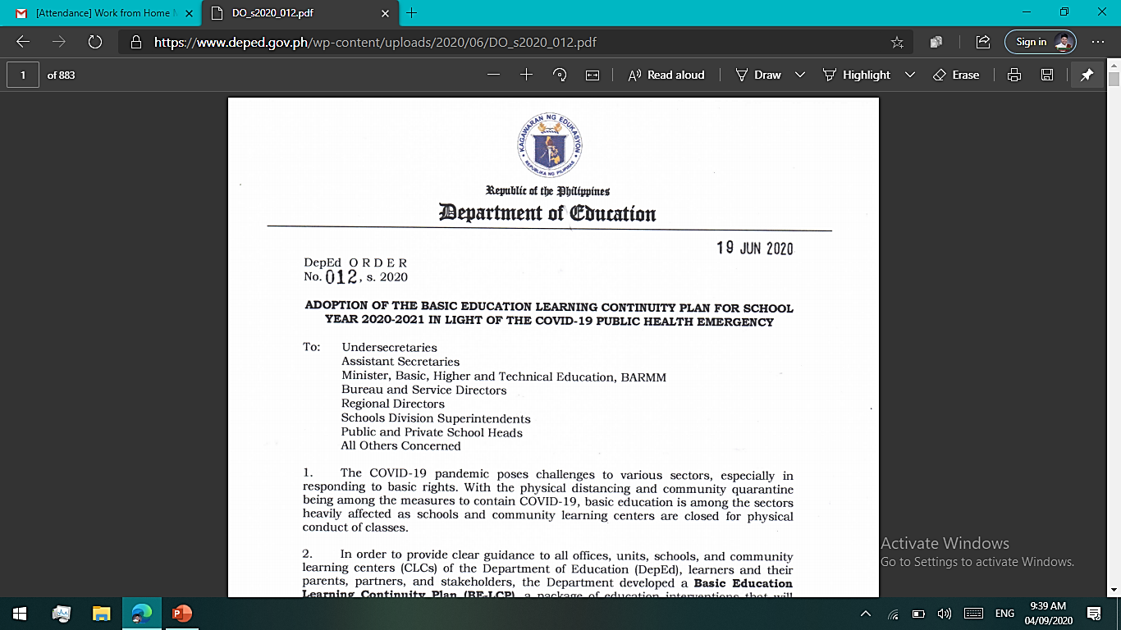
Context
The impact of the COVID-19 pandemic on SY 2020-2021:
  Change in the demand for teaching and learning
  Shift to distance learning delivery modalities
  Development of learning resources for distance learning
  Need to upskill and retool teachers on the new learning delivery
Notes:
Purpose of the slide: To explain the context of the RPMS SY 2020-2021
Note to the Presenter:
The demand for teaching and learning has changed for the School Year 2020-2021 as a result of the impact of the COVID-19 pandemic.
The Department of Education (DepEd) shifted focus to various distance learning delivery modalities (DLDMs).
The Department is focused on developing learning resources and upskilling and retooling teachers to support the DLDMs.

Slide 3
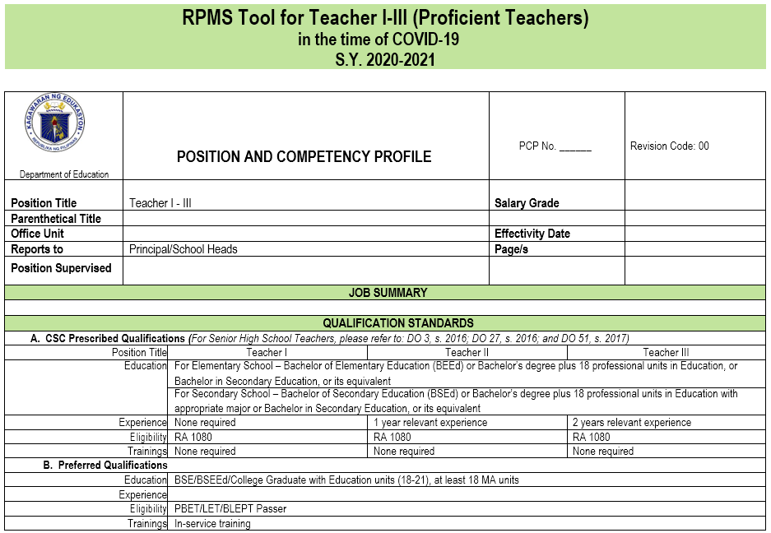
Context
As the learning delivery changes, so do the duties of teachers to their learners and the performance expected of them.
The expectations of teachers must be captured in their performance assessment through a more contextualized Results-based Performance Management System (RPMS).
Notes:
Purpose of the slide: To explain the context of the RPMS SY 2020-2021
Note to the Presenter:
As the learning delivery changes, so do the duties of teachers to their learners and the performance expected of them.
The expectations of teachers must be captured in their performance assessment through a more contextualized Results-based Performance Management System (RPMS).

Slide 4
Context
Modifications in RPMS, its tools, processes, and protocols, for SY 2020-2021 were made on the following:
  Objectives taken from the PPST priority indicators
  Means of verification
  Performance indicators
  Classroom observation processes and protocols (alternatives)
  Timeline in the RPMS cycle (adjusted)
Notes:
Purpose of the slide: To explain the context of the RPMS SY 2020-2021
Note to the Presenter:
The modifications in RPMS, its tools, processes, and protocols, for SY 2020-2021 captures the DepEd current system that governs teachers’ functions.
Emphasize that selected RPMS objectives from PPST indicators, means of verification (MOV), and performance indicators (PI) for RPMS Year 2 will assist teachers to adapt and/or respond more quickly and effectively to emerging circumstances associated with challenges brought by the pandemic.

Slide 5






The development of RPMS in the context of COVID-19
Consultations with DepEd officials and partners
Series of meetings within BHROD and with RCTQ to review and finalize tools
Focus Group Discussion
Revision on tools were based on quantitative and qualitative data gathered from April to October 2020
RPMS
SY 2020-2021 in the time of COVID-19
Held on 29 July 2020; participated by teachers, ALS teacher, master teachers, head teachers, school heads, PSDS, EPS, and representatives from BLD, BEA, BHROD
Validation of tools, processes, protocols
Document Analysis
Literatures on emergency remote learning; DepEd issuances such as the BE-LCP in the time of COVID-19, memoranda on learning delivery; Data from BE-LCP dry run and Learner Enrollment and Survey
Held on 9-14 September 2020; participated by teachers, ALS & SPED teachers, special science teachers, master teachers, head teachers, assistant principals, school heads, specialists, and EPS from 16 DepEd regions
Notes:
Purpose of the slide: To explain the development of RPMS SY 2020-2021 in the time of the COVID-19 pandemic
Notes to the Presenter:
The RPMS SY 2020-2021 in the time of COVID-19 tools and materials were developed following a research process.
The development phase involved consultations with DepEd officials and partners; a focus group discussion with select teachers, school heads, and supervisors; and document analysis of literatures on emergency remote teaching and of various DepEd issuances in relation to the BE-LCP.
The validation phase involved a national online validation of RPMS tools and alternative processes and protocols for the school year. All these went through a series of planning and review meetings within DepEd and with RCTQ.

Slide 6
PPST Priority Indicators
  11 PPST priority indicators chosen as RPMS objectives for SY 2020-2021
  Selected based on being more responsive and appropriate to the current context of the teachers, learners, and the learning environment
Notes:
Purpose of the slide: To explain the development of RPMS SY 2020-2021 in the time of the COVID-19 pandemic
Note to the Presenter:
There are 11 priority indicators from the Philippine Professional Standards for Teachers (PPST) chosen as RPMS objectives for this school year.
These priority indicators were selected based on being more responsive and appropriate to the current context of the teachers, learners, and the learning environment.

Slide 7
RPMS Objectives taken from PPST Priority Indicators for Teacher I-III (Proficient Teachers)
Applied knowledge of content within and across curriculum teaching areas
Ensured the positive use of ICT to facilitate the teaching and learning process
Applied a range of teaching strategies to develop critical and creative thinking, as well as other higher-order thinking skills
Established a learner-centered culture by using teaching strategies that respond to their linguistic, cultural, socioeconomic and religious backgrounds
Planned and delivered teaching strategies that are responsive to the special educational needs of learners in difficult circumstances, including: geographic isolation; chronic illness; displacement due to armed conflict, urban resettlement or disasters; child abuse and child labor practices
Used strategies for providing timely, accurate and constructive feedback to improve learner performance
Selected, developed, organized and used appropriate teaching and learning resources, including ICT, to address learning goals
Notes:
Purpose of the slide: To show the RPMS objectives taken from the PPST priority indicators for T I-III
Note to the Presenter:
Read the slide.

Slide 8
RPMS Objectives taken from PPST Priority Indicators for Teacher I-III (Proficient Teachers)
Set achievable and appropriate learning outcomes that are aligned with learning competencies
Built relationships with parents/ guardians and the wider school community to facilitate involvement in the educative process
Participated in professional networks to share knowledge and to enhance practice
Developed a personal improvement plan based on reflection of one’s practice and ongoing professional learning
7 - Classroom Observable Objectives
4 - Non-Classroom Observable Objectives
1 - Plus Factor .
12 RPMS-PPST Objectives
Notes:
Purpose of the slide: To show the RPMS objectives taken from the PPST priority indicators for T I-III
Note to the Presenter:
Read the slide.

Slide 9
RPMS Objectives taken from PPST Priority Indicators for Master Teachers I-IV (Highly Proficient Teachers)
Modelled effective applications of content knowledge within and across curriculum teaching areas
Promoted effective strategies in the positive use of ICT to facilitate the teaching and learning process
Developed and applied effective teaching strategies to promote critical and creative thinking, as well as other higher-order thinking skills
Exhibited a learner-centered culture that promotes success by using effective teaching strategies that respond to their linguistic, cultural, socioeconomic and religious backgrounds
Evaluated with colleagues teaching strategies that are responsive to the special educational needs of learners in difficult circumstances, including: geographic isolation; chronic illness; displacement due to armed conflict, urban resettlement or disasters; child abuse and child labor practices
Used effective strategies for providing timely, accurate and constructive feedback to encourage learners to reflect on and improve their own learning
Advised and guided colleagues in the selection, organization, development and use of appropriate teaching and learning resources, including ICT, to address specific learning goals
Notes:
Purpose of the slide: To show the RPMS objectives taken from the PPST priority indicators for MT I-IV
Note to the Presenter:
Read the slide.

Slide 10
RPMS Objectives taken from PPST Priority Indicators for Master Teachers I-IV (Highly Proficient Teachers)
Modelled to colleagues the setting of achievable and challenging learning outcomes that are aligned with learning competencies to cultivate a culture of excellence for all learners
Guided colleagues to strengthen relationships with parents/ guardians and the wider school community to maximize their involvement in the educative process
Contributed actively to professional networks within and between schools to improve knowledge and to enhance practice
Initiated professional reflections and promote learning opportunities with colleagues to improve practice
7 - Classroom Observable Objectives
4 - Non-Classroom Observable Objectives
1 - Plus Factor .
12 RPMS-PPST Objectives
Notes:
Purpose of the slide: To show the RPMS objectives taken from the PPST priority indicators for MT I-IV
Note to the Presenter:
Read the slide.

Slide 11
Questions?
Notes:
Purpose of the slide: To prompt participants to process what they have learned so far and ask for clarifications
Notes to the Presenter:
Encourage participants to ask questions. Remind them that they should also be able to respond queries when they rollout the capacity building, so this is their chance to ask questions that they expect from the field.

Slide 12
Contact Us
Bureau of Human Resource and Organizational Development-Human Resource Development Division (BHROD-HRDD)
bhrod.hrdd@deped.gov.ph
Ma. Paula Bianca Manas
Project Development Officer III
ma.manas@deped.gov.ph
Cecille Anyayahan
Project Development Officer IV
cecille.anyayahan@deped.gov.ph

Slide 13
Presentation Slides prepared by
Dr. Allen A. Espinosa
RCTQ Senior Program Manager
espinosa.aa@pnu.edu.ph
Donnadette SG. Belza
RCTQ Project Officer
belza.ds@pnu.edu.ph
Jonathan J. Lumanog, Jr.
RCTQ Research Officer
lumanog.jj@pnu.edu.ph
Contact Us
Phone +63 2 53171768 Local 763/764
Telefax +63 2 53369755
Web http://www.rctq.ph/
Email rctq@pnu.edu.ph

